Slide 1
Time Series and Signal Modelling
T. Tang (with special thanks to Prof. Steve Roberts for the source material)
Day 3
Summer School in Hands-on Machine Learning 2026
Notes:
[Timing: 1 minutes]
Timing: approximately 1 minute.
Teaching notes: Use this slide to orient the next part of the source sequence.
[Sources]
- Visual template: provided Day 1 deck.

Slide 2
How the lecture fits together
1 UNDERSTAND THE DATA What was measured? Use time plots, sampling checks, filters, Fast Fourier Transform (FFT), Discrete Fourier Transform (DFT), Autocorrelation Function (ACF), Partial Autocorrelation Function (PACF) and cross-correlation.
2 DEFINE THE FORECAST What must we predict, how far ahead, and what is known when the prediction is made?
3 CHOOSE A MODEL Start with baselines and Autoregressive (AR) or state-space models; use Gaussian Process (GP), Temporal Convolutional Network (TCN), Long Short-Term Memory (LSTM), Gated Recurrent Unit (GRU) or newer models when the data justify them.
4 CHECK IT WORKS Test on later time periods, quantify uncertainty and check new machines or operating conditions.
Notes:
[Timing: 3 minutes]
Frame the lecture as a decision process. The first act extracts structure, the second defines the map from available history to required future, the third chooses a model family, and the fourth asks whether the resulting forecast is trustworthy.
[Sources]
- Supplied Day 1/Day 2 PDFs and the current Day 3 deck.

Slide 3
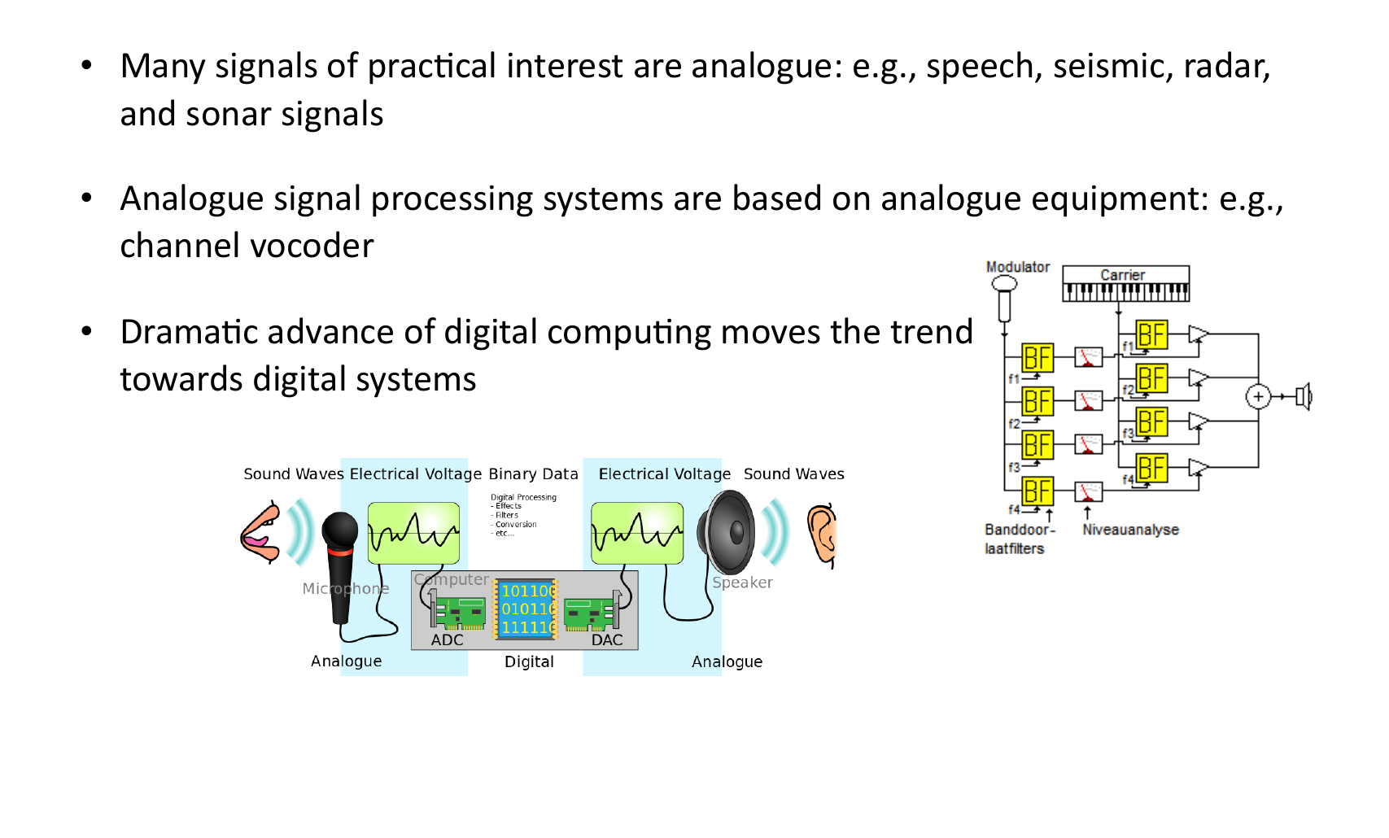
First inspect what was actually measured
Notes:
[Timing: 2 minutes]
Timing: approximately 2 minutes.
Teaching notes: Use the supplied source figure as the teaching focus. Follow its derivation or build in the printed order, define every symbol, and connect the final statement to the previous slide.
[Sources]
- Provided IE_CDT_SP_HT25_D1.pdf, page 15.

Slide 4
1A. Sampling: what information did the sensor record?
Notes:
[Timing: 0.5 minutes]
Timing: approximately 0.5 minutes.
Teaching notes: Use this slide to orient the next part of the source sequence.
[Sources]
- Visual template: provided Day 1 deck.

Slide 5
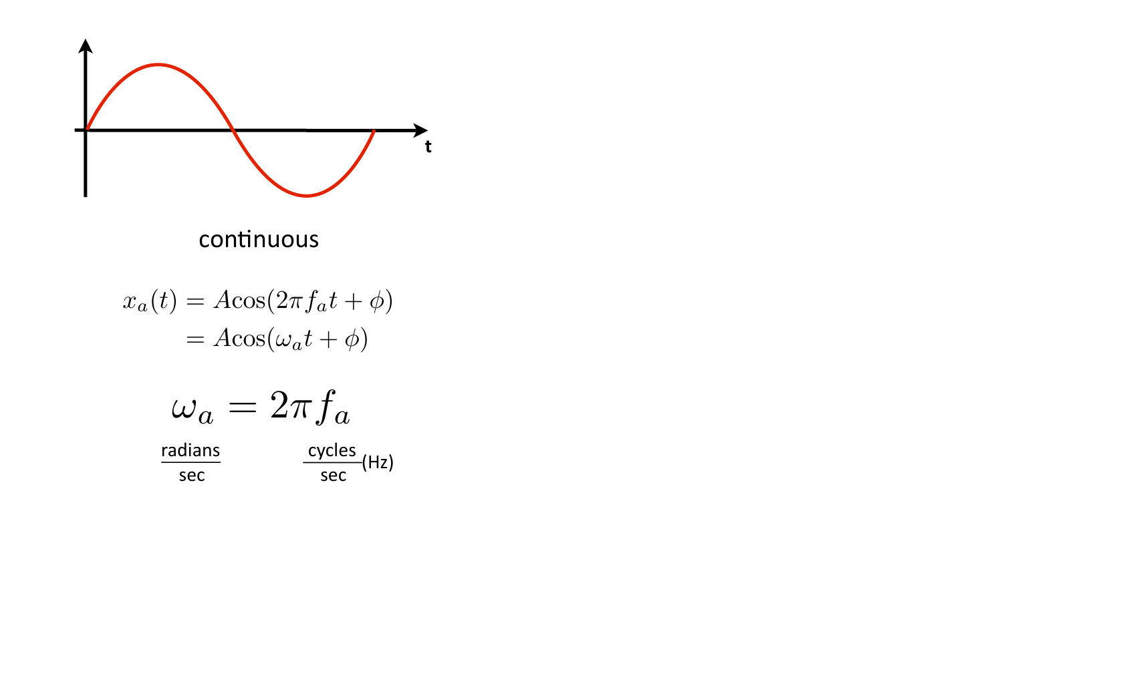
Sampling records the signal at discrete times
Notes:
[Timing: 1 minutes]
Timing: approximately 1 minute.
Teaching notes: Use the supplied source figure as the teaching focus. Follow its derivation or build in the printed order, define every symbol, and connect the final statement to the previous slide.
[Sources]
- Provided IE_CDT_SP_HT25_D1.pdf, page 66.

Slide 6
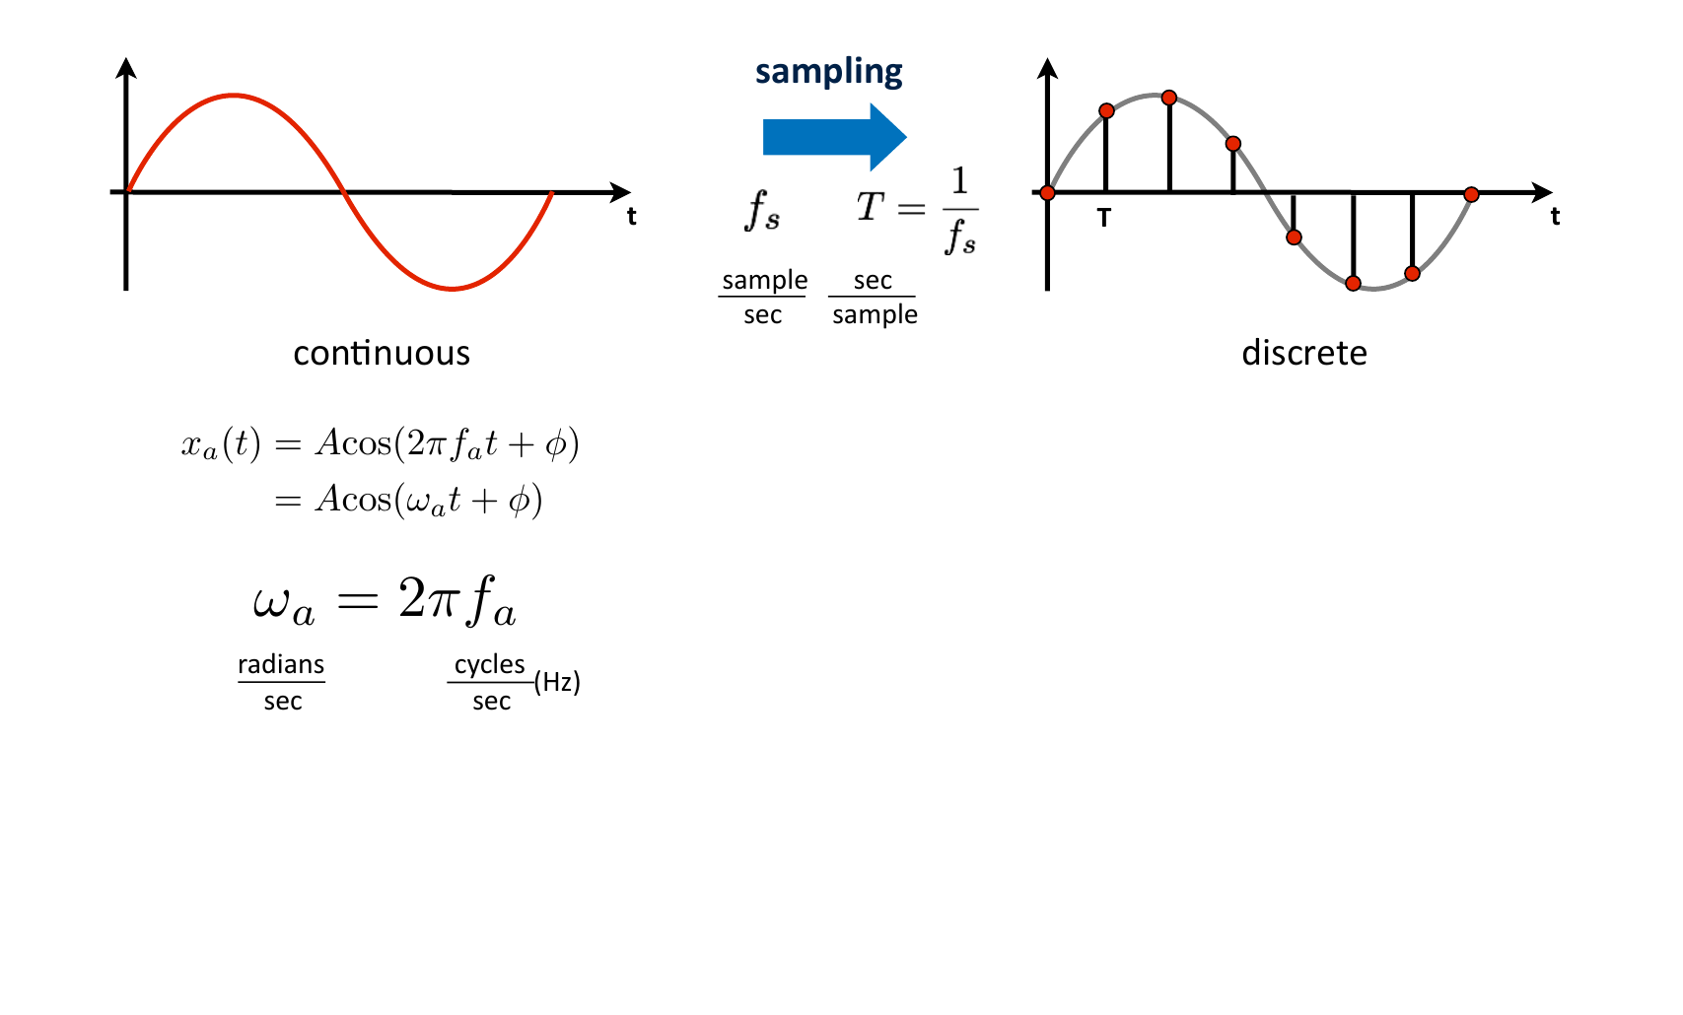
A continuous signal becomes a sequence of numbers
Notes:
[Timing: 1 minutes]
Timing: approximately 1 minute.
Teaching notes: Use the supplied source figure as the teaching focus. Follow its derivation or build in the printed order, define every symbol, and connect the final statement to the previous slide.
[Sources]
- Provided IE_CDT_SP_HT25_D1.pdf, page 67.

Slide 7
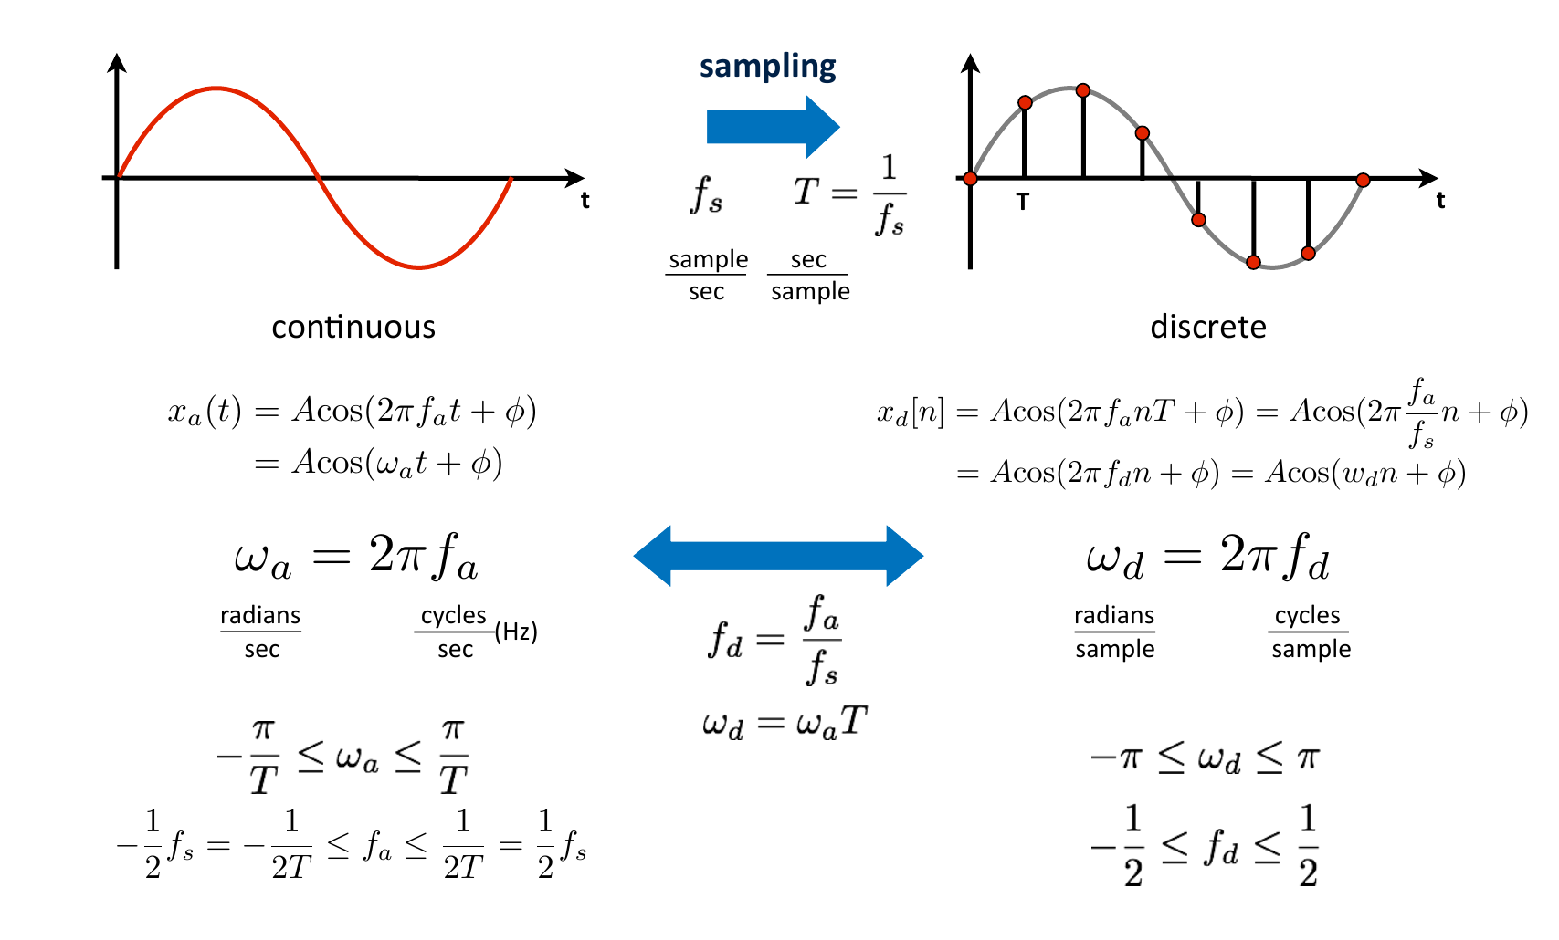
Digital frequency is measured relative to the sample rate
Notes:
[Timing: 1.5 minutes]
Timing: approximately 1.5 minutes.
Teaching notes: Use the supplied source figure as the teaching focus. Follow its derivation or build in the printed order, define every symbol, and connect the final statement to the previous slide.
[Sources]
- Provided IE_CDT_SP_HT25_D1.pdf, page 69.

Slide 8
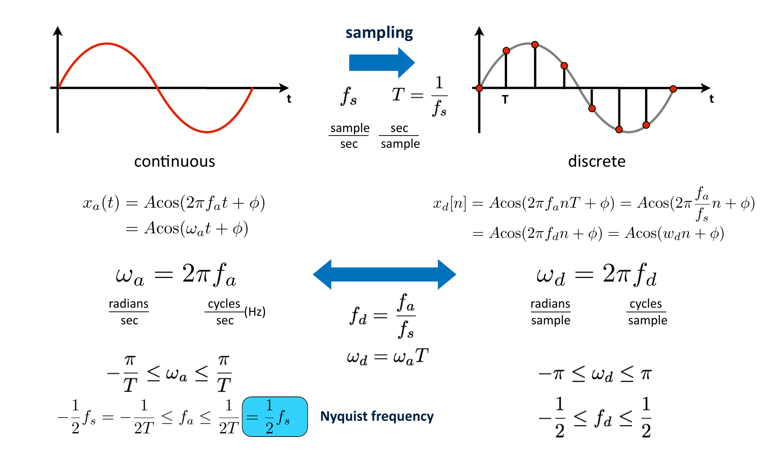
The sample rate must be more than twice the highest frequency
Notes:
[Timing: 1.5 minutes]
Timing: approximately 1.5 minutes.
Teaching notes: Use the supplied source figure as the teaching focus. Follow its derivation or build in the printed order, define every symbol, and connect the final statement to the previous slide.
[Sources]
- Provided IE_CDT_SP_HT25_D1.pdf, page 70.

Slide 9
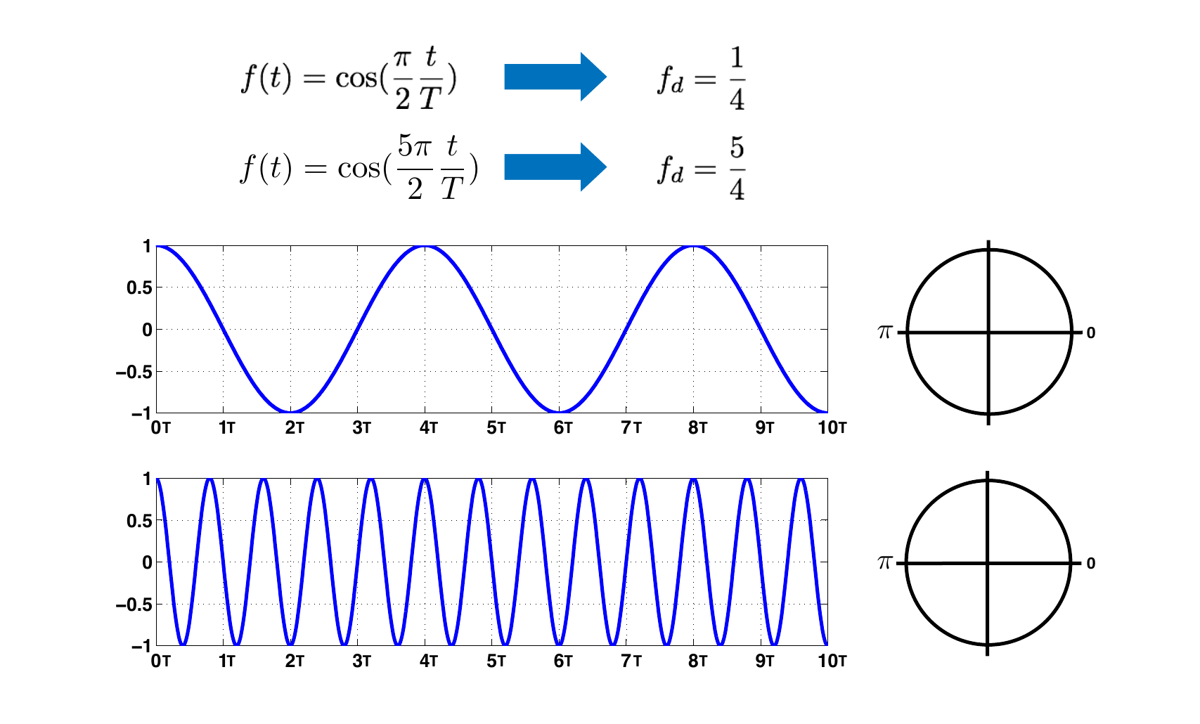
Aliasing makes a fast oscillation look slower
Notes:
[Timing: 1 minutes]
Timing: approximately 1 minute.
Teaching notes: Use the supplied source figure as the teaching focus. Follow its derivation or build in the printed order, define every symbol, and connect the final statement to the previous slide.
[Sources]
- Provided IE_CDT_SP_HT25_D1.pdf, page 71.

Slide 10
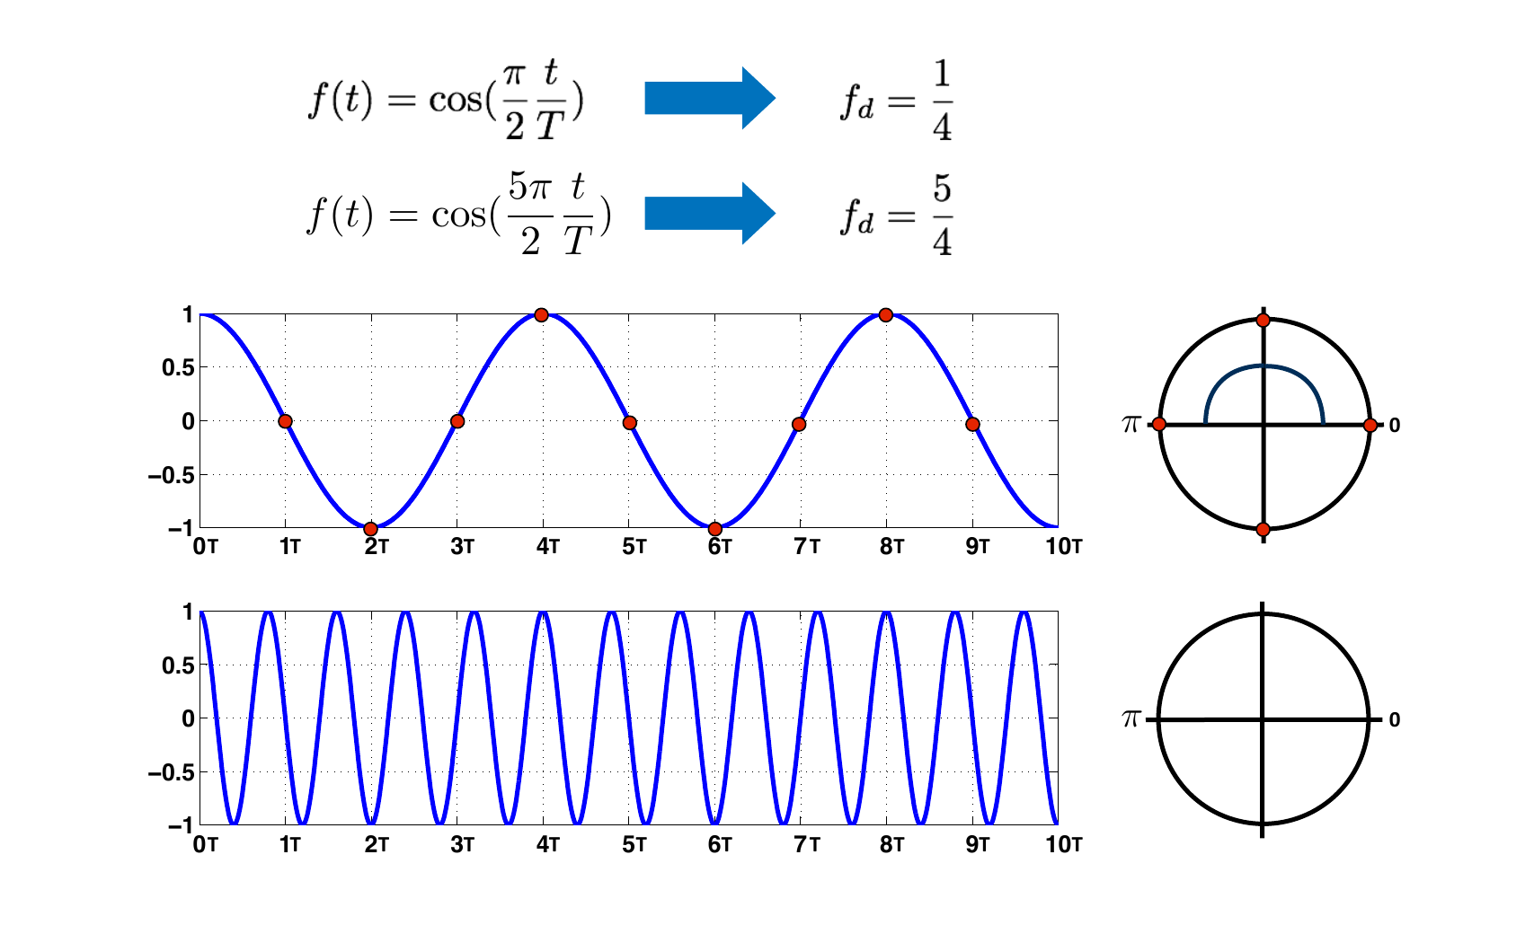
Different continuous signals can produce the same samples
Notes:
[Timing: 1 minutes]
Timing: approximately 1 minute.
Teaching notes: Use the supplied source figure as the teaching focus. Follow its derivation or build in the printed order, define every symbol, and connect the final statement to the previous slide.
[Sources]
- Provided IE_CDT_SP_HT25_D1.pdf, page 74.

Slide 11
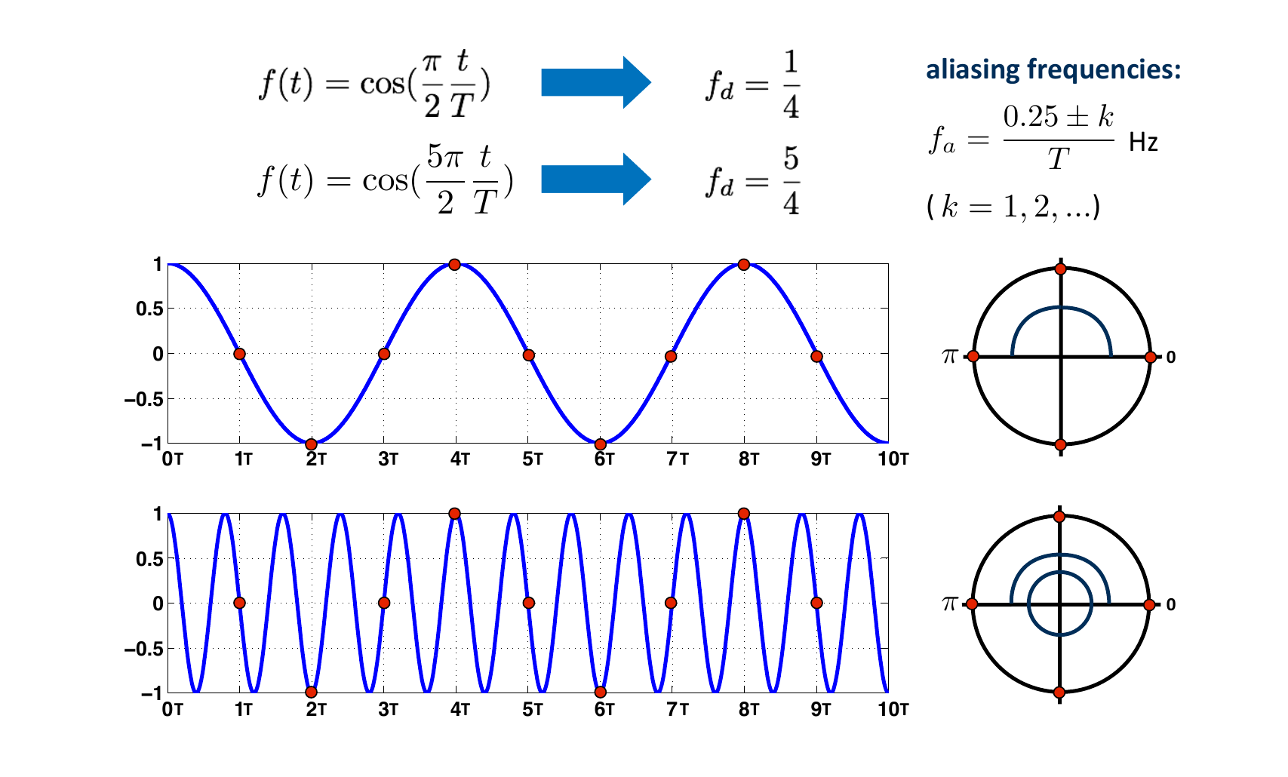
Aliased frequencies fold into the measured range
Notes:
[Timing: 1.5 minutes]
Timing: approximately 1.5 minutes.
Teaching notes: Use the supplied source figure as the teaching focus. Follow its derivation or build in the printed order, define every symbol, and connect the final statement to the previous slide.
[Sources]
- Provided IE_CDT_SP_HT25_D1.pdf, page 78.

Slide 12
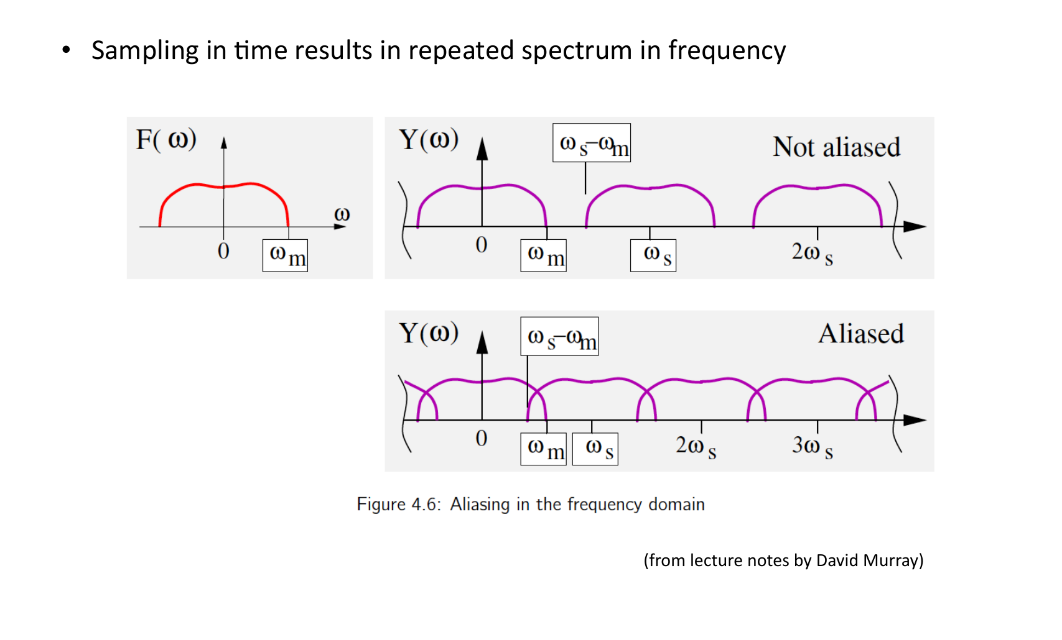
Aliasing also appears in the frequency spectrum
Notes:
[Timing: 1.5 minutes]
Timing: approximately 1.5 minutes.
Teaching notes: Use the supplied source figure as the teaching focus. Follow its derivation or build in the printed order, define every symbol, and connect the final statement to the previous slide.
[Sources]
- Provided IE_CDT_SP_HT25_D1.pdf, page 79.

Slide 13
1B. Filtering: separate useful structure from noise
Notes:
[Timing: 0.5 minutes]
Timing: approximately 0.5 minutes.
Teaching notes: Use this slide to orient the next part of the source sequence.
[Sources]
- Visual template: provided Day 1 deck.

Slide 14
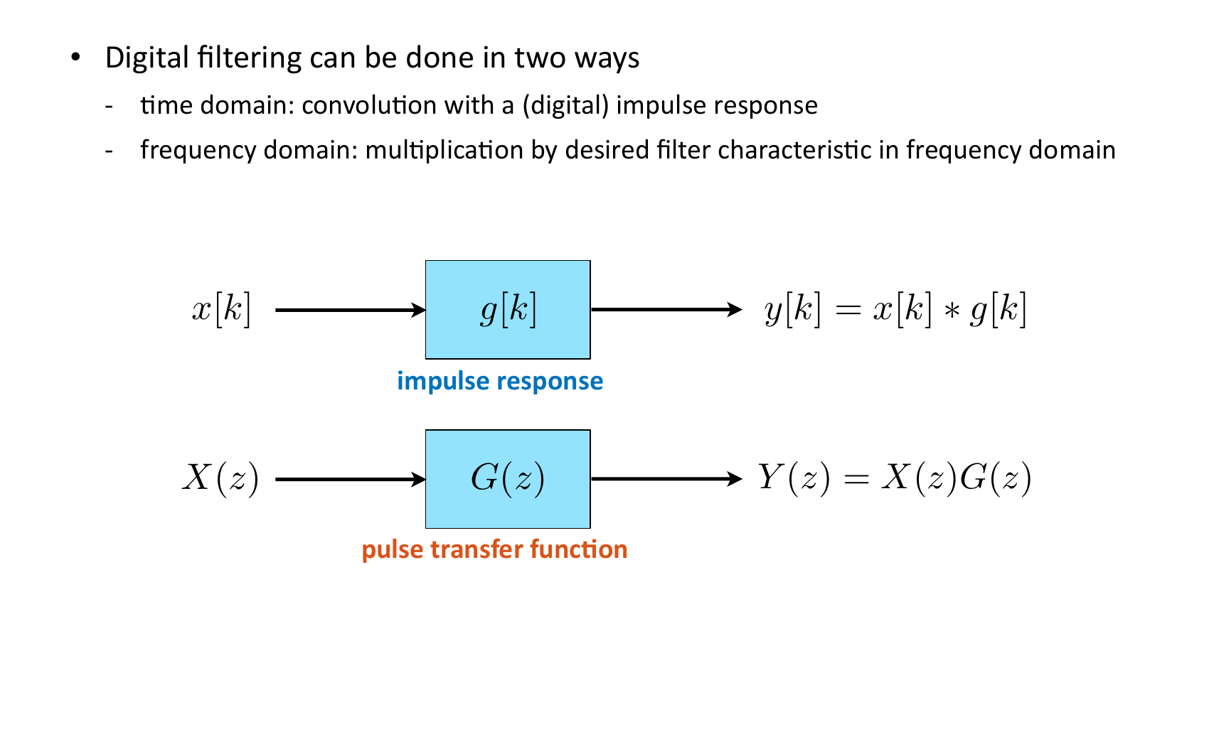
A digital filter keeps some features and suppresses others
Notes:
[Timing: 1 minutes]
Timing: approximately 1 minute.
Teaching notes: Use the supplied source figure as the teaching focus. Follow its derivation or build in the printed order, define every symbol, and connect the final statement to the previous slide.
[Sources]
- Provided IE_CDT_SP_HT25_D1.pdf, page 65.

Slide 15
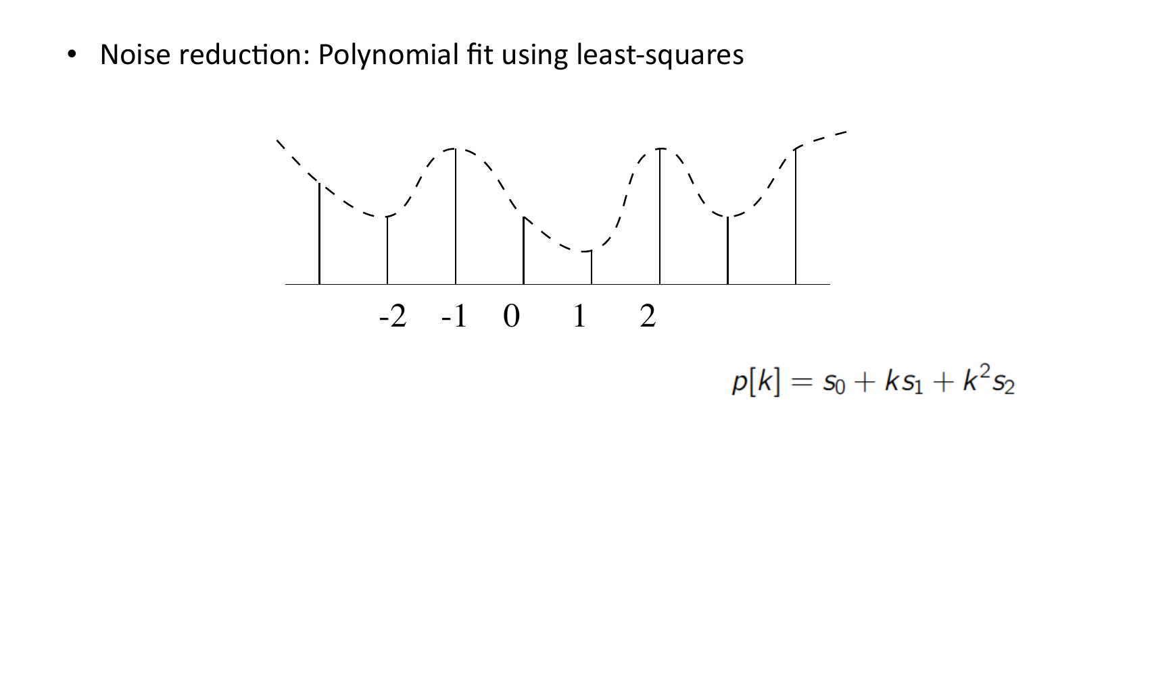
A filter is a weighted regression on nearby samples
Notes:
[Timing: 2 minutes]
Timing: approximately 2 minutes.
Teaching notes: Use the supplied source figure as the teaching focus. Follow its derivation or build in the printed order, define every symbol, and connect the final statement to the previous slide.
[Sources]
- Provided IE_CDT_SP_HT25_D1.pdf, page 80.

Slide 16
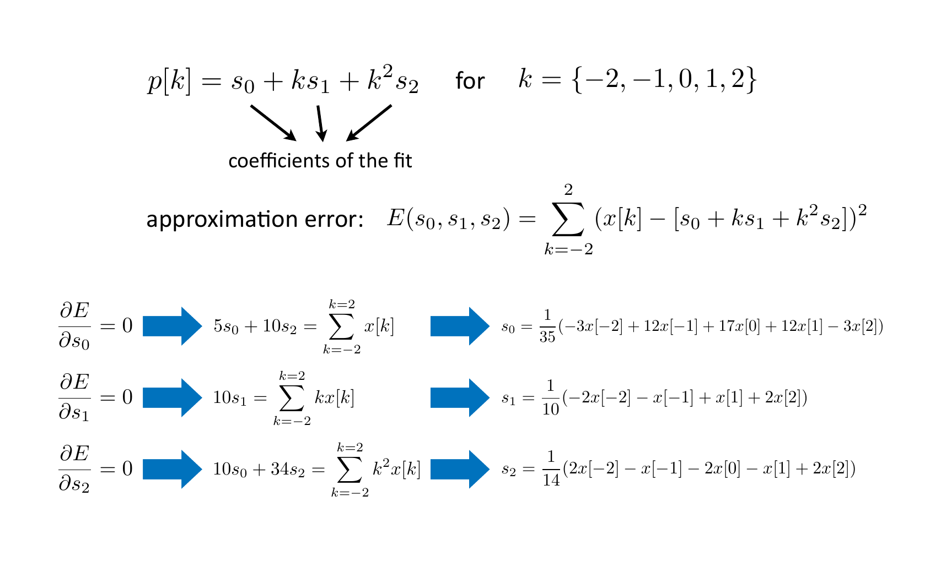
Least squares chooses the filter weights
Notes:
[Timing: 2 minutes]
Timing: approximately 2 minutes.
Teaching notes: Use the supplied source figure as the teaching focus. Follow its derivation or build in the printed order, define every symbol, and connect the final statement to the previous slide.
[Sources]
- Provided IE_CDT_SP_HT25_D1.pdf, page 85.

Slide 17
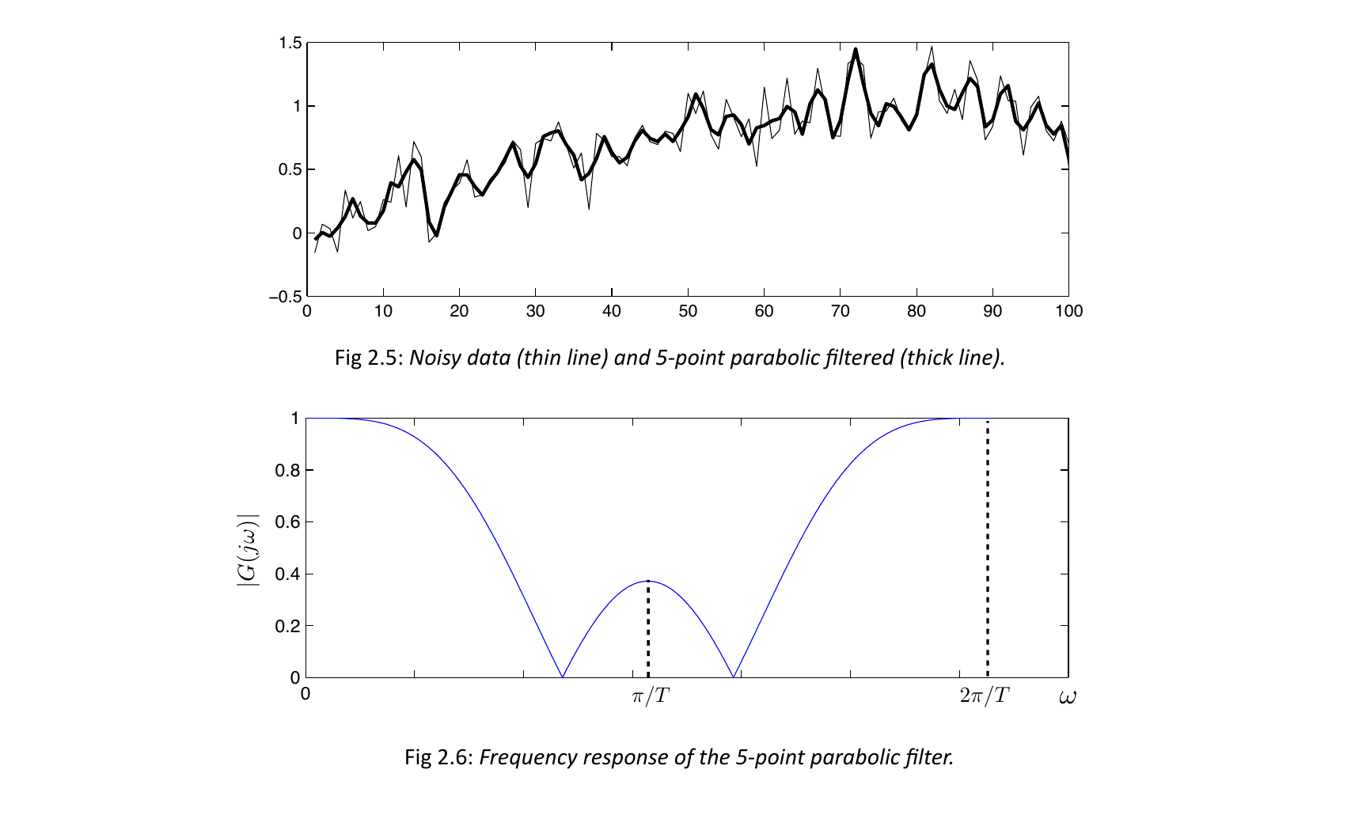
The parabolic filter smooths noise while keeping local shape
Notes:
[Timing: 1.5 minutes]
Timing: approximately 1.5 minutes.
Teaching notes: Use the supplied source figure as the teaching focus. Follow its derivation or build in the printed order, define every symbol, and connect the final statement to the previous slide.
[Sources]
- Provided IE_CDT_SP_HT25_D1.pdf, page 87.

Slide 18
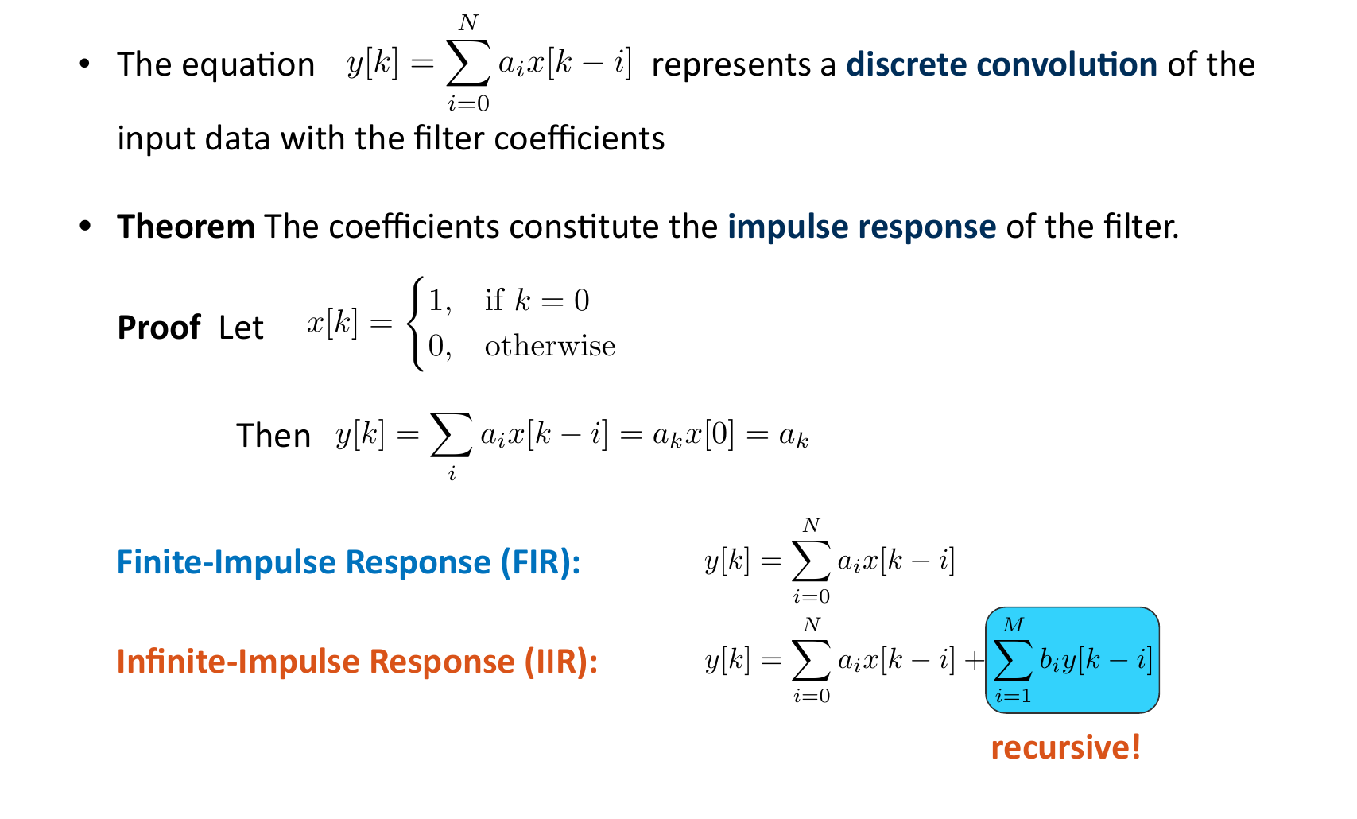
Two filter types remember the past differently
Notes:
[Timing: 2 minutes]
Timing: approximately 2 minutes.
Teaching notes: Use the supplied source figure as the teaching focus. Follow its derivation or build in the printed order, define every symbol, and connect the final statement to the previous slide.
[Sources]
- Provided IE_CDT_SP_HT25_D1.pdf, page 95.

Slide 19
1C. Fourier analysis: find the frequencies in the data
Notes:
[Timing: 0.5 minutes]
Timing: approximately 0.5 minutes.
Teaching notes: Use this slide to orient the next part of the source sequence.
[Sources]
- Visual template: provided Day 1 deck.

Slide 20
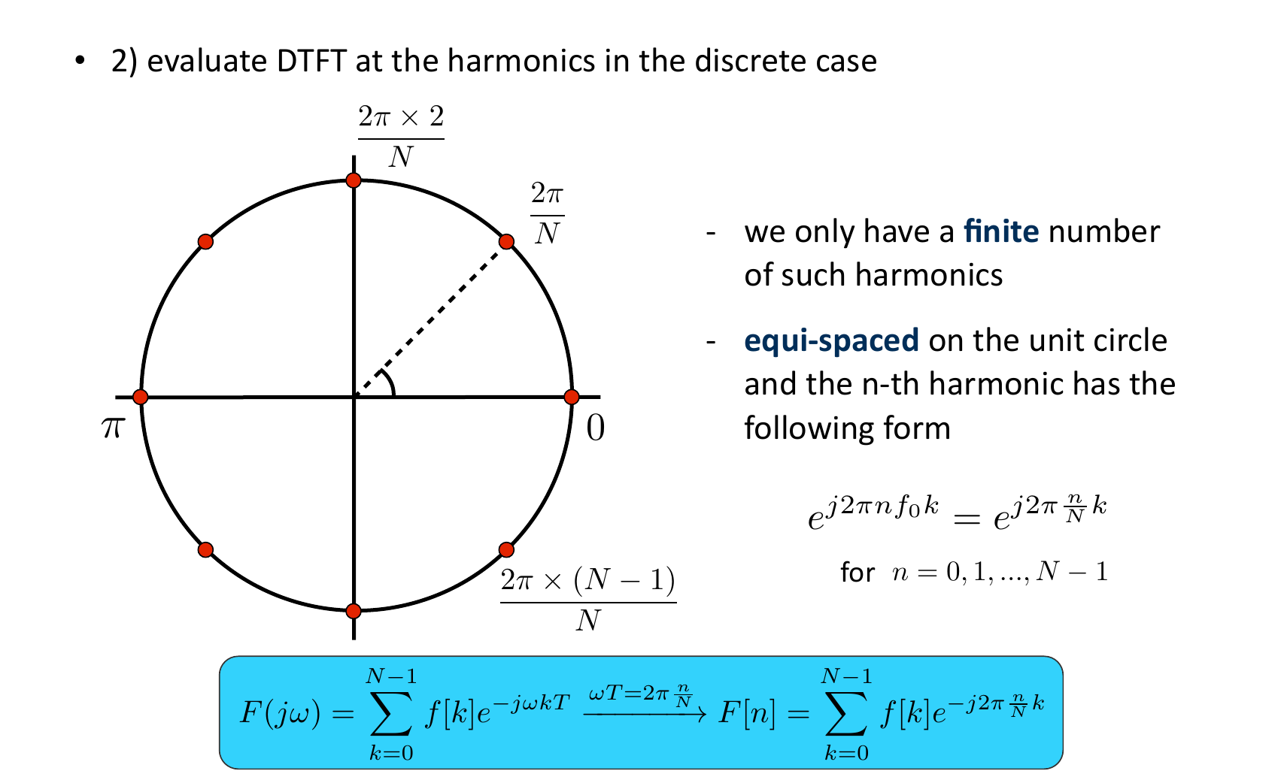
The discrete Fourier transform tests each frequency
Notes:
[Timing: 1.5 minutes]
Timing: approximately 2 minutes.
Teaching notes: Use the supplied source figure as the teaching focus. Follow its derivation or build in the printed order, define every symbol, and connect the final statement to the previous slide.
[Sources]
- Provided IE_CDT_SP_HT25_D1.pdf, page 165.

Slide 21
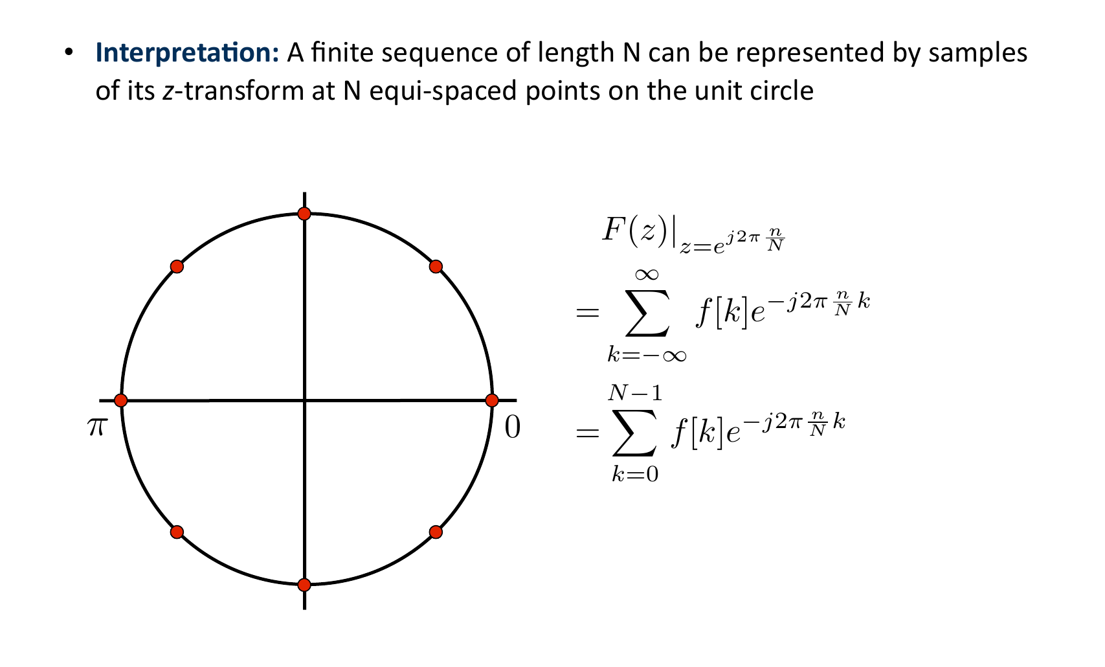
Fourier magnitude gives strength; phase gives timing
Notes:
[Timing: 1.5 minutes]
Timing: approximately 1.5 minutes.
Teaching notes: Use the supplied source figure as the teaching focus. Follow its derivation or build in the printed order, define every symbol, and connect the final statement to the previous slide.
[Sources]
- Provided IE_CDT_SP_HT25_D1.pdf, page 171.

Slide 22
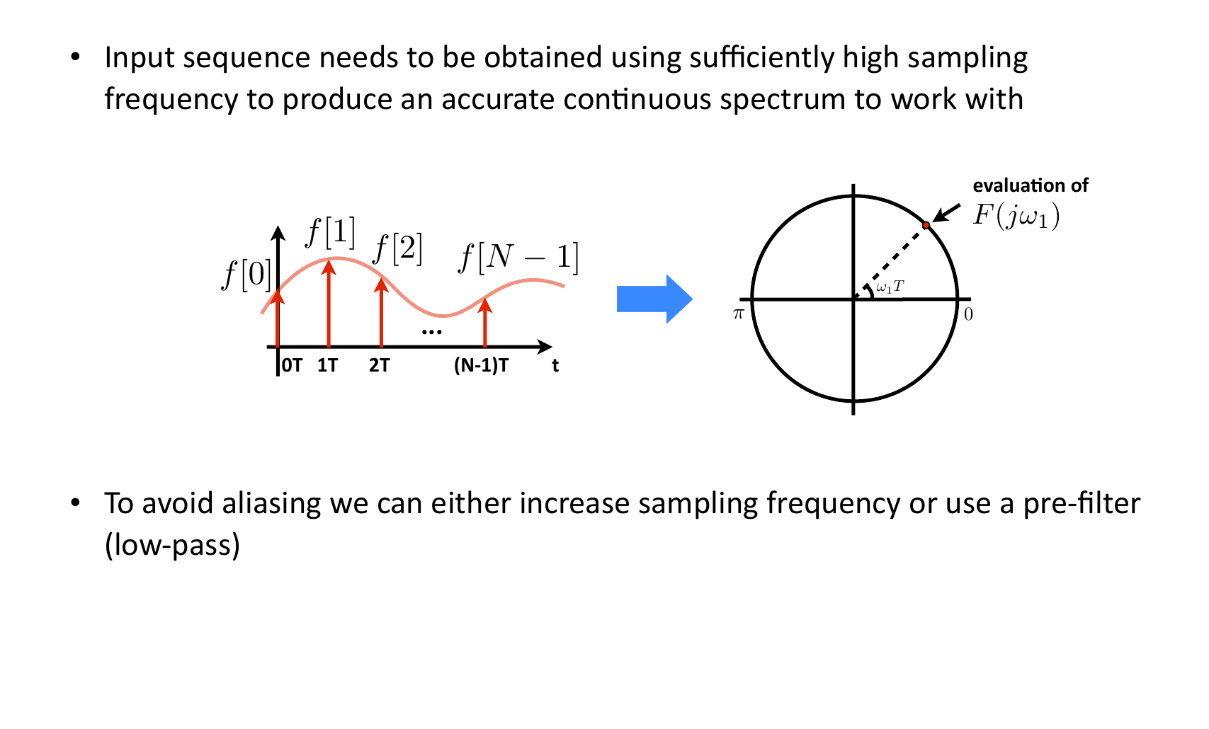
Aliasing creates the wrong frequency
Notes:
[Timing: 2 minutes]
Timing: approximately 1 minute.
Teaching notes: Use the supplied source figure as the teaching focus. Follow its derivation or build in the printed order, define every symbol, and connect the final statement to the previous slide.
[Sources]
- Provided IE_CDT_SP_HT25_D1.pdf, page 188.

Slide 23
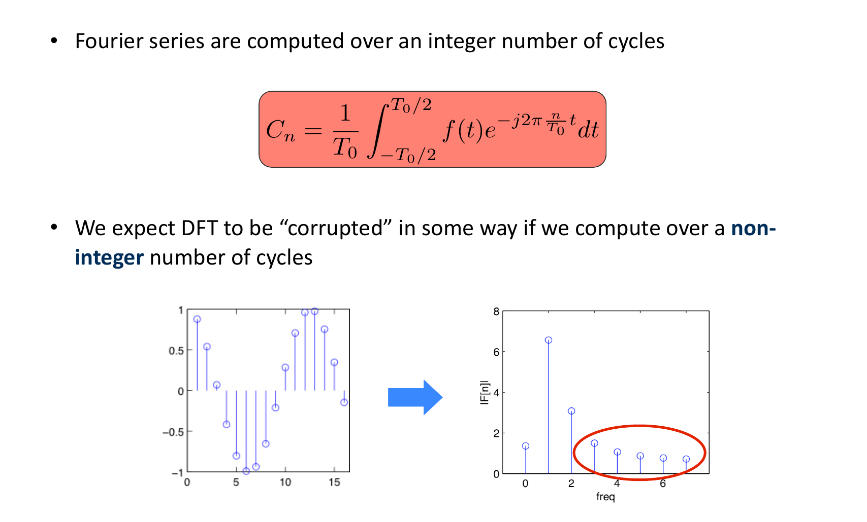
Leakage spreads one frequency across neighbouring bins
Notes:
[Timing: 2 minutes]
Timing: approximately 1.5 minutes.
Teaching notes: Use the supplied source figure as the teaching focus. Follow its derivation or build in the printed order, define every symbol, and connect the final statement to the previous slide.
[Sources]
- Provided IE_CDT_SP_HT25_D1.pdf, page 190.

Slide 24
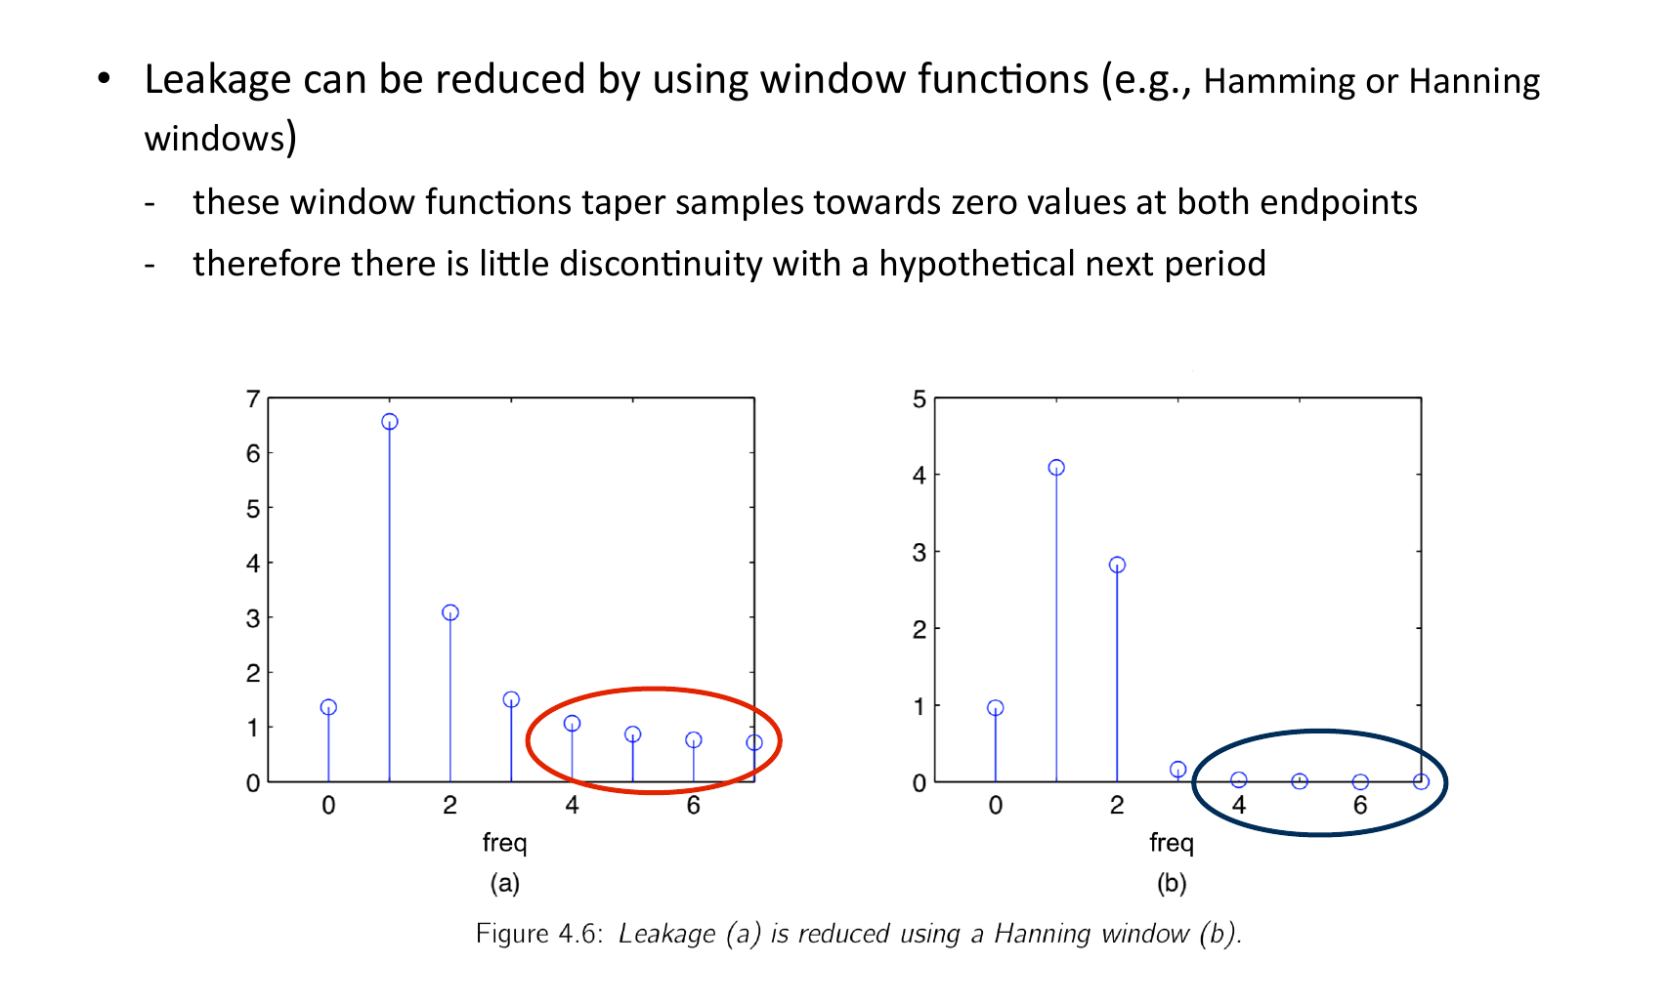
Windowing reduces leakage at the edges
Notes:
[Timing: 1.5 minutes]
Timing: approximately 1.5 minutes.
Teaching notes: Use the supplied source figure as the teaching focus. Follow its derivation or build in the printed order, define every symbol, and connect the final statement to the previous slide.
[Sources]
- Provided IE_CDT_SP_HT25_D1.pdf, page 193.

Slide 25
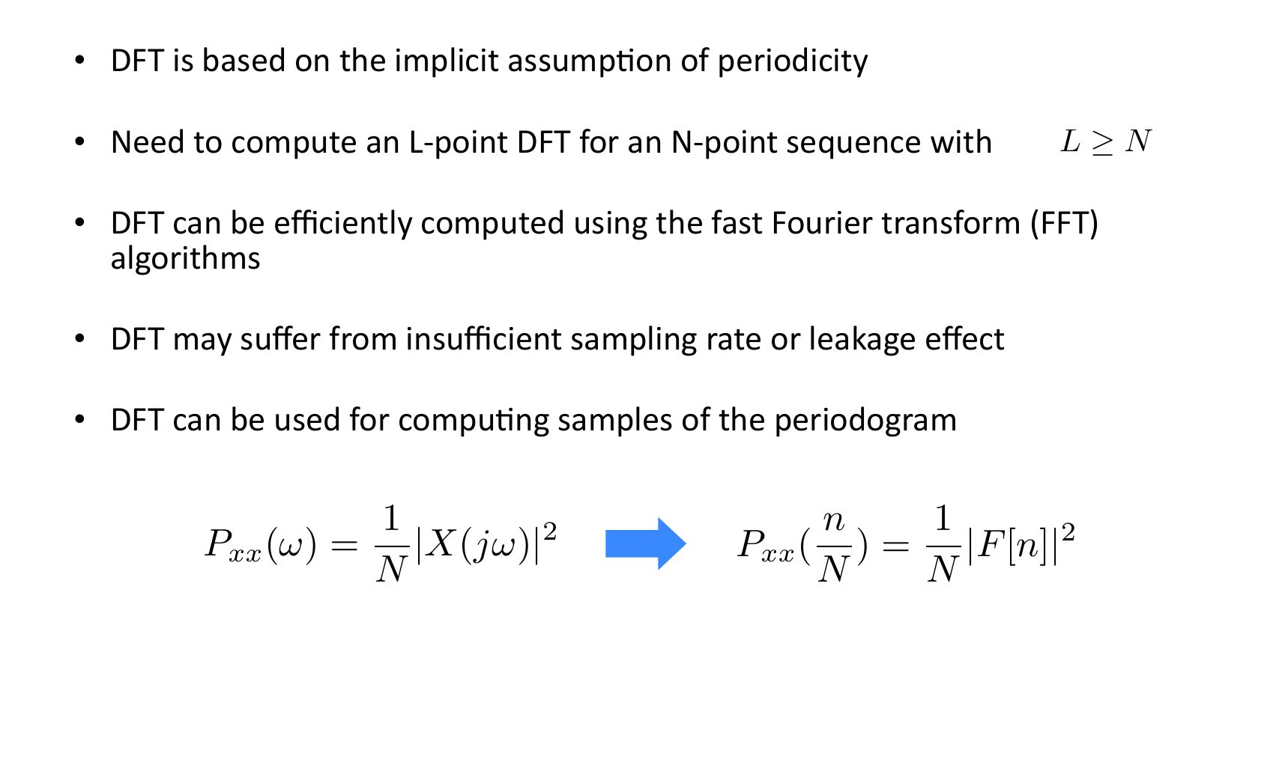
Fourier analysis reveals cycles in the data
Notes:
[Timing: 2.5 minutes]
Timing: approximately 1 minute.
Teaching notes: Use the supplied source figure as the teaching focus. Follow its derivation or build in the printed order, define every symbol, and connect the final statement to the previous slide.
[Sources]
- Provided IE_CDT_SP_HT25_D1.pdf, page 194.

Slide 26
1D. Correlation: find memory and time delays
Notes:
[Timing: 0.5 minutes]
Connect the preceding DFT material to time-domain dependence. The purpose of ACF, PACF and cross-correlation is to expose repeatable structure before modelling.
[Sources]
- Narrative structure synthesised from the supplied two-day time-series material and S3-L1/S3-L2/S3-L3 learning outcomes.

Slide 27
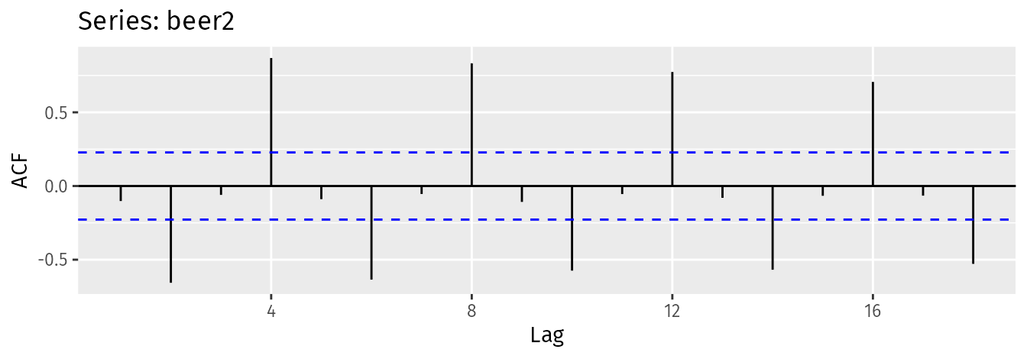
Autocorrelation shows whether the signal remembers its past
• Autocorrelation function (ACF): compares a signal with a delayed copy of itself.
• Partial autocorrelation function (PACF): asks whether one lag adds new information after shorter lags.
• Cross-correlation function (CCF): compares two signals while shifting one in time.
Peaks can reveal persistence, repeated cycles and useful time delays.
Notes:
[Timing: 2.5 minutes]
Read several prominent lags from the ACF and ask whether they suggest persistence or seasonality. Explain that ACF includes direct and propagated dependence; PACF and CCF answer different questions.
[Sources]
- Visual: Hyndman & Athanasopoulos, Forecasting: Principles and Practice, 2nd ed., https://otexts.com/fpp2/autocorrelation.html
- Technical reference: Box, Jenkins, Reinsel & Ljung, Time Series Analysis.

Slide 28
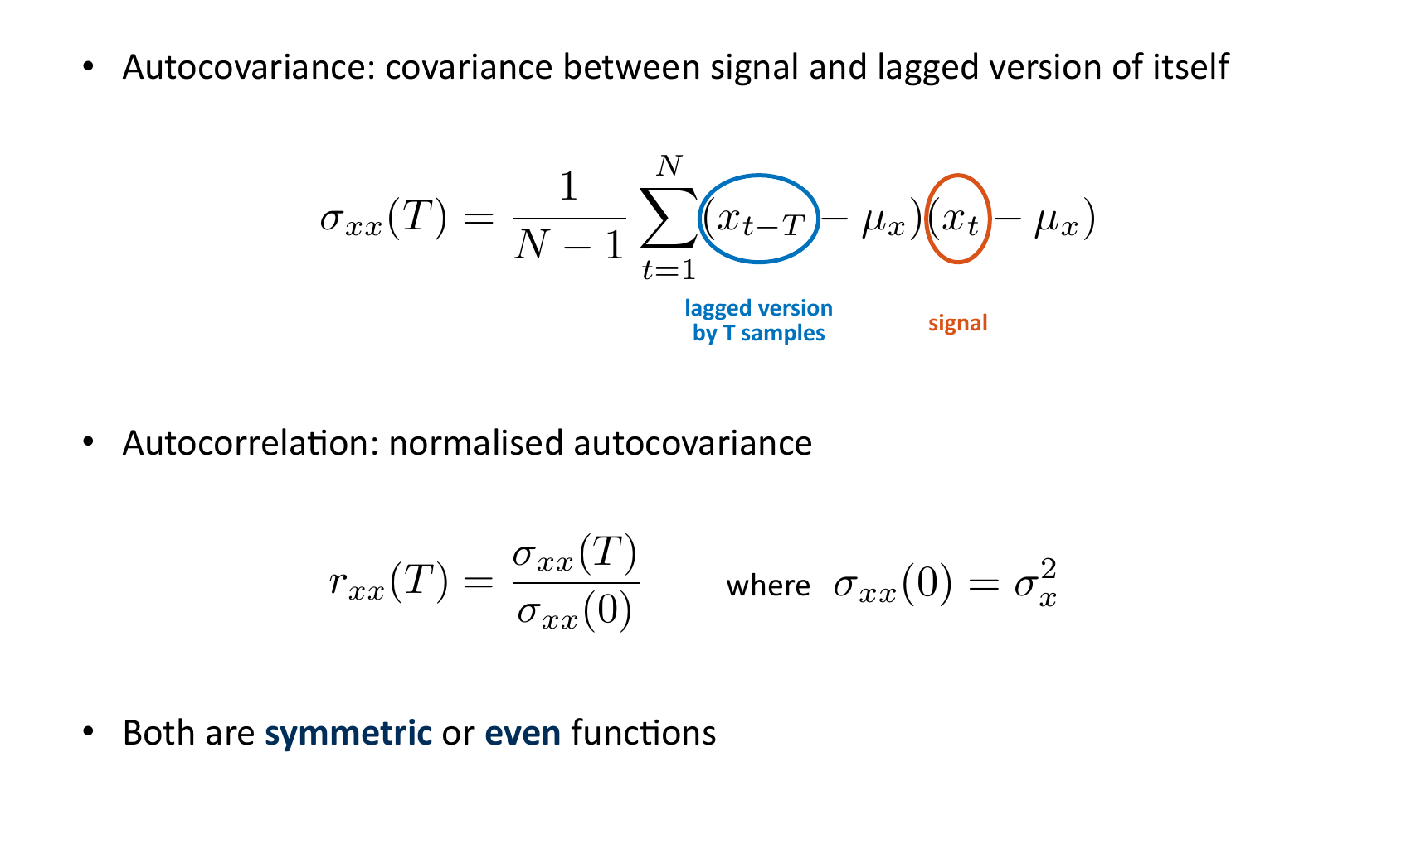
Autocorrelation compares the signal with a delayed copy
Notes:
[Timing: 2 minutes]
Timing: approximately 2 minutes.
Teaching notes: Use the supplied source figure as the teaching focus. Follow its derivation or build in the printed order, define every symbol, and connect the final statement to the previous slide.
[Sources]
- Provided IE_CDT_SP_HT25_D2.pdf, page 111.

Slide 29
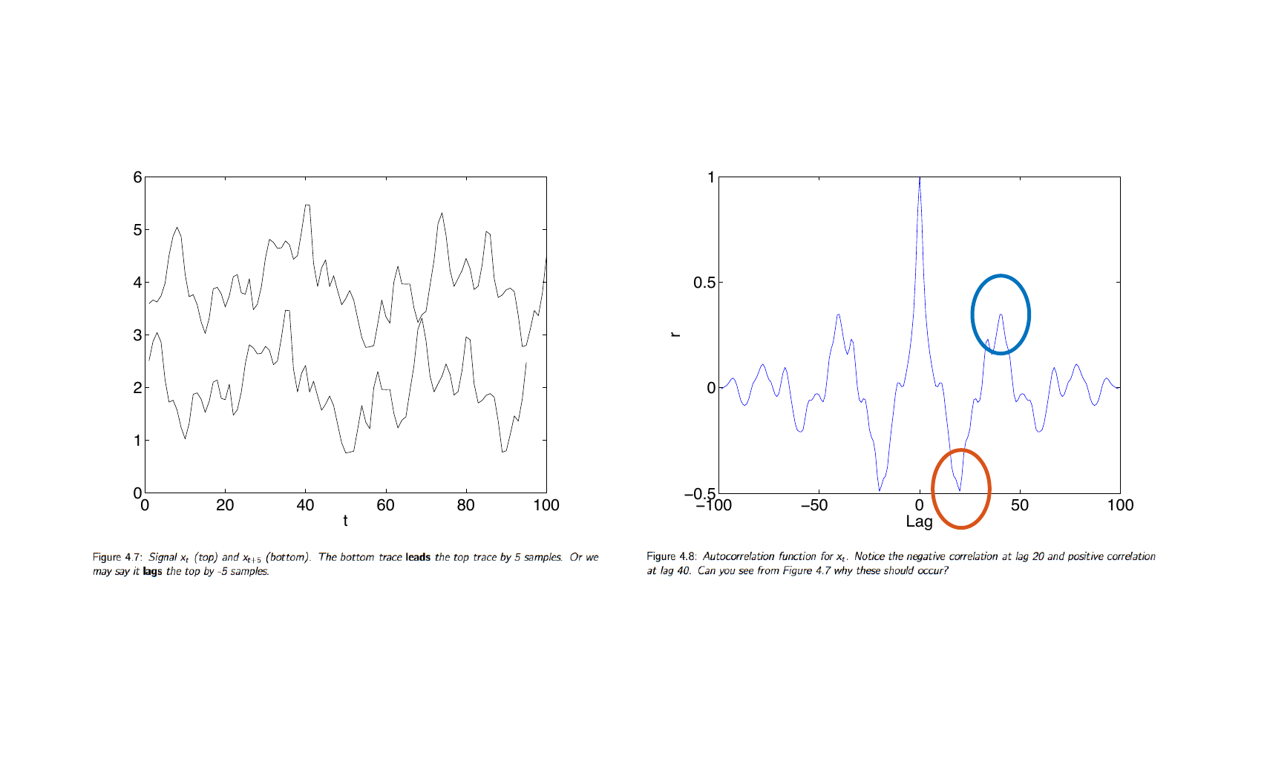
Autocorrelation peaks reveal repeated time scales
Notes:
[Timing: 2 minutes]
Timing: approximately 2 minutes.
Teaching notes: Use the supplied source figure as the teaching focus. Follow its derivation or build in the printed order, define every symbol, and connect the final statement to the previous slide.
[Sources]
- Provided IE_CDT_SP_HT25_D2.pdf, page 113.

Slide 30
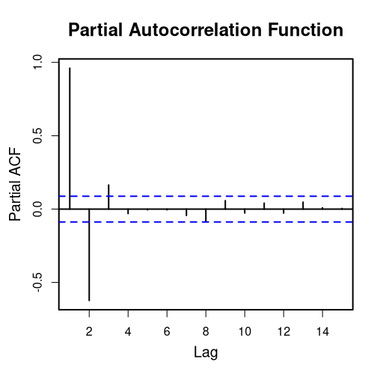
Partial autocorrelation helps choose the autoregressive order
• Autocorrelation function (ACF): can stay large because information passes through intermediate lags.
• Partial autocorrelation function (PACF): removes the effect of the shorter lags.
• Ideal autoregressive model of order p, AR(p): the partial autocorrelation function becomes small after lag p.
PACF(k) = Corr(yₜ, yₜ₋ₖ | yₜ₋₁,…,yₜ₋ₖ₊₁)
Use the partial autocorrelation function to suggest p; then check prediction errors on later data.
Notes:
[Timing: 2 minutes]
Contrast an ideal AR(1), whose ACF decays but PACF cuts off after lag 1, with an ideal moving-average process. The clean cut-off is a diagnostic under textbook conditions, not a guarantee on real data.
[Sources]
- Visual: Moon motif, Partial Autocorrelation Function Graph, Wikimedia Commons, CC BY-SA 4.0, https://commons.wikimedia.org/wiki/File:Partial_Autocorrelation_Function_Graph.png
- Technical reference: Box, Jenkins, Reinsel & Ljung, Time Series Analysis.

Slide 31
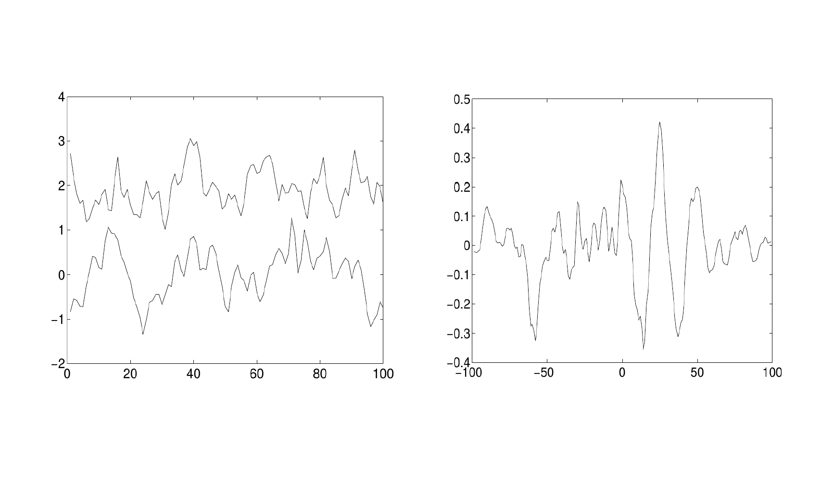
Cross-correlation compares two signals at different time delays
Notes:
[Timing: 2 minutes]
Timing: approximately 1.5 minutes.
Teaching notes: Use the supplied source figure as the teaching focus. Follow its derivation or build in the printed order, define every symbol, and connect the final statement to the previous slide.
[Sources]
- Provided IE_CDT_SP_HT25_D2.pdf, page 137.

Slide 32
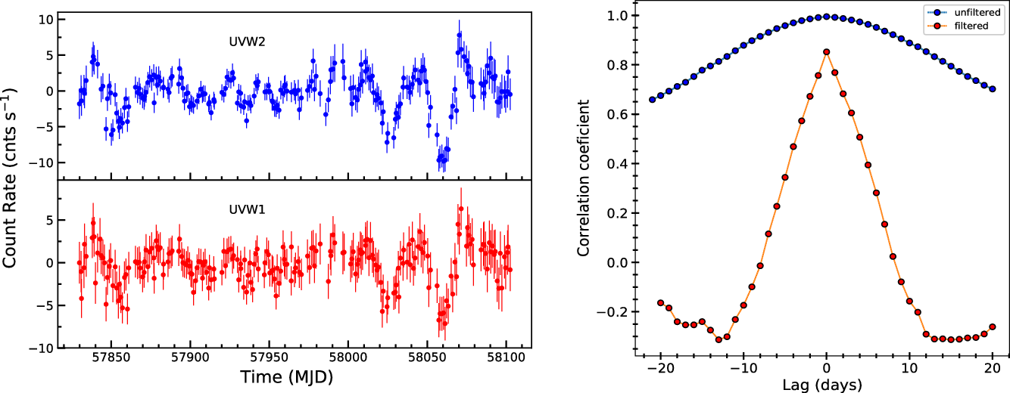
Clean and align both signals before reading a time delay
• Remove shared trend: otherwise unrelated signals can appear correlated.
• Align the clocks: correct timestamp and sensor delays.
• Test the lag: keep it only if it improves forecasts on later data.
A peak suggests a useful delay; it does not prove cause and effect.
Notes:
[Timing: 2 minutes]
Compare filtered and unfiltered cross-correlation. Shared low-frequency movement can create a broad, impressive peak. Pre-whitening asks whether innovations in one series predict innovations in the other.
[Sources]
- Visual: Cambridge Core figure from Complex optical/UV and X-ray variability in Seyfert 1 galaxy Mrk 509, https://www.cambridge.org/core/journals/publications-of-the-astronomical-society-of-australia/article/complex-opticaluv-and-xray-variability-in-seyfert-1-galaxy-mrk-509/
- Technical reference: Box, Jenkins, Reinsel & Ljung, Time Series Analysis.

Slide 33
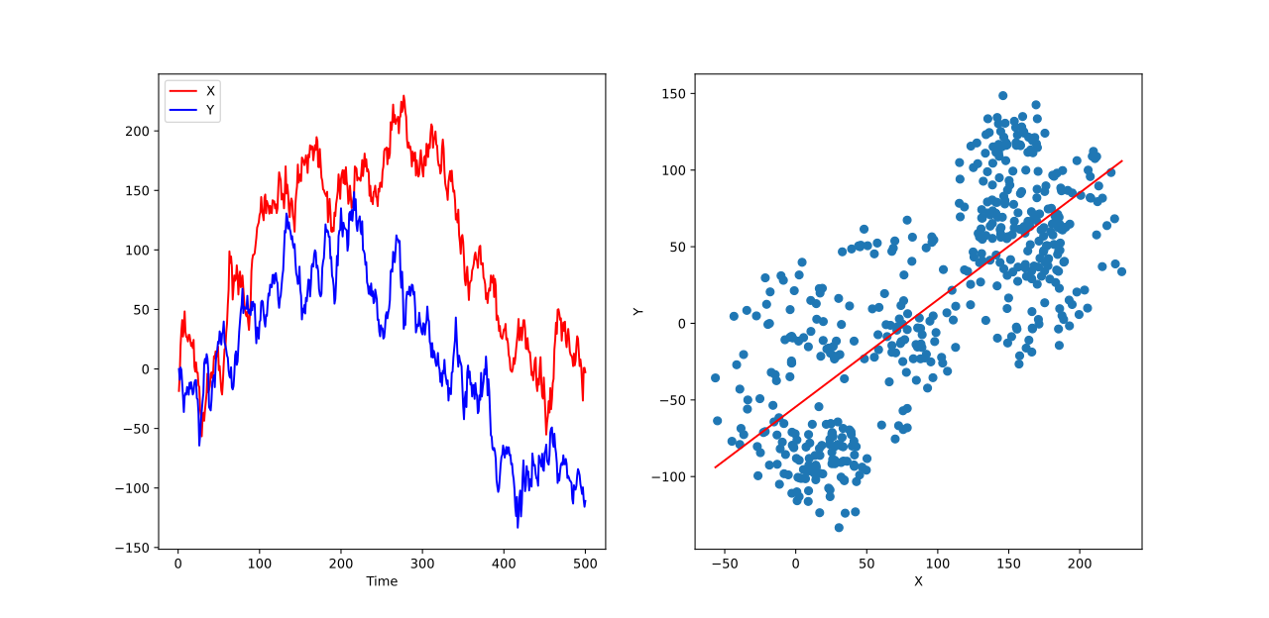
Check whether the behaviour changes over time
• Stationary: average level, variation and correlation pattern stay roughly stable.
• Non-stationary: trend, ageing, changing load, interventions or a new regime.
• What to do: detrend or difference, add operating variables, or use a model that can change.
Stationary means the same lag pattern can be reused later.
If the data-generating behaviour changes, the old model may no longer be valid.
Notes:
[Timing: 2.5 minutes]
Use the spurious-regression picture to show why shared low-frequency behaviour can look predictive. Distinguish weak stationarity from strict stationarity and avoid presenting differencing as an automatic preprocessing step.
[Sources]
- Visual: Kwj2772, Spurious regression with non-stationary time series, Wikimedia Commons, CC BY 4.0, https://commons.wikimedia.org/wiki/File:Spurious_regression_with_non-stationary_time_series.svg
- Hyndman & Athanasopoulos, Forecasting: Principles and Practice, 3rd ed.

Slide 34
2. Define exactly what must be forecast
Notes:
[Timing: 0.5 minutes]
Before choosing a model, formalise the target, forecast origin, horizon, known-future inputs and evaluation protocol. This turns an informal time-series question into a supervised mapping.
[Sources]
- Narrative structure synthesised from the supplied two-day time-series material and S3-L1/S3-L2/S3-L3 learning outcomes.

Slide 35
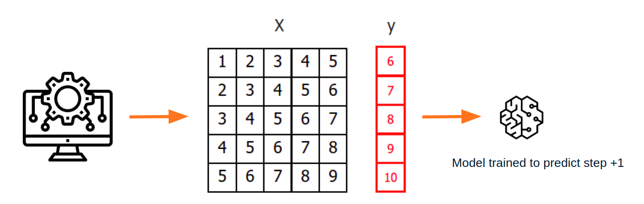
Write the forecasting question before choosing a model
• What: which quantity or event must be predicted?
• When: one step ahead, ten seconds ahead, or the whole future path?
• Known inputs: which measurements and planned inputs truly exist at prediction time?
past measurements + known future inputs → forecast h steps ahead
A model can only use information that exists when the forecast is made.
Notes:
[Timing: 2.5 minutes]
Use concrete examples to distinguish one-step prediction, path forecasting and risk forecasting. Ask whether planned control actions or weather forecasts are genuinely available at the forecast origin.
[Sources]
- Visual: skforecast documentation, https://skforecast.org/latest/introduction-forecasting/introduction-forecasting
- Hyndman & Athanasopoulos, Forecasting: Principles and Practice, 3rd ed.

Slide 36
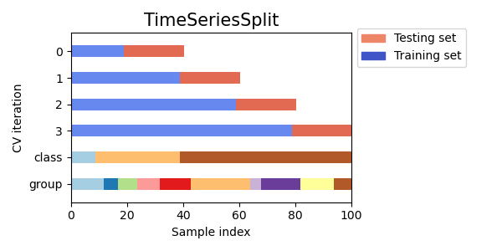
Train on earlier data and test on later data
• Keep time order: each test period occurs after its training period.
• Leave a gap: use one when filters or windows overlap.
• Repeat preprocessing: fit scaling and feature selection using training data only.
The final test period is an untouched piece of the future.
Notes:
[Timing: 2.5 minutes]
Point to the expanding training windows and later test blocks. Explain how fitting preprocessing on all timestamps leaks future distributional information even when the forecasting model itself is trained chronologically.
[Sources]
- Visual: scikit-learn TimeSeriesSplit example, BSD-3-Clause, https://scikit-learn.org/stable/auto_examples/model_selection/plot_cv_indices.html
- Tashman (2000), Out-of-sample tests of forecasting accuracy.

Slide 37
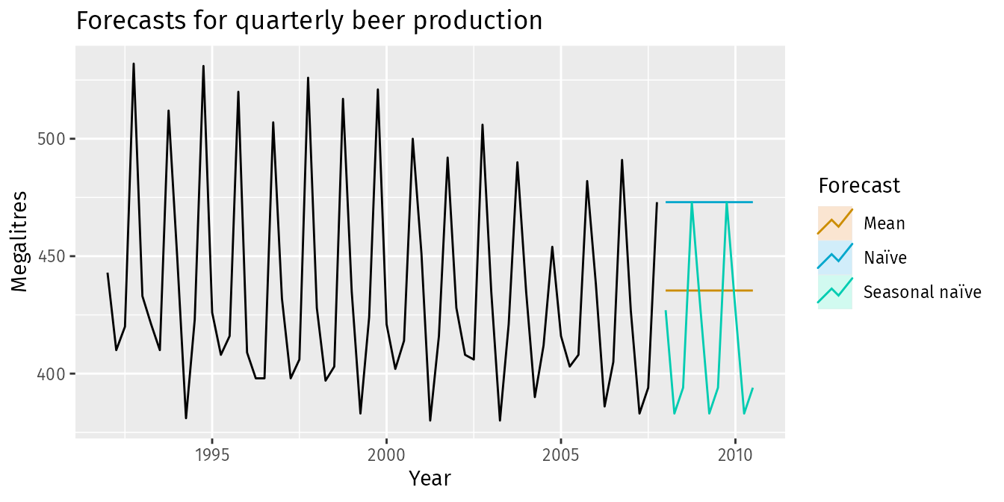
Simple forecasts are the first models to beat
MEAN: long-run average NAÏVE: last value
SEASONAL NAÏVE: last cycle DRIFT: straight-line trend
An advanced model is useful only if it beats these baselines on future data.
Notes:
[Timing: 2.5 minutes]
Ask which baseline should win for a slowly drifting sensor, a seasonal load series and a stationary zero-mean signal. The baseline must use the same horizon, information and retraining schedule as the candidate.
[Sources]
- Visual: Hyndman & Athanasopoulos, Forecasting: Principles and Practice, 2nd ed., https://otexts.com/fpp2/simple-methods.html

Slide 38
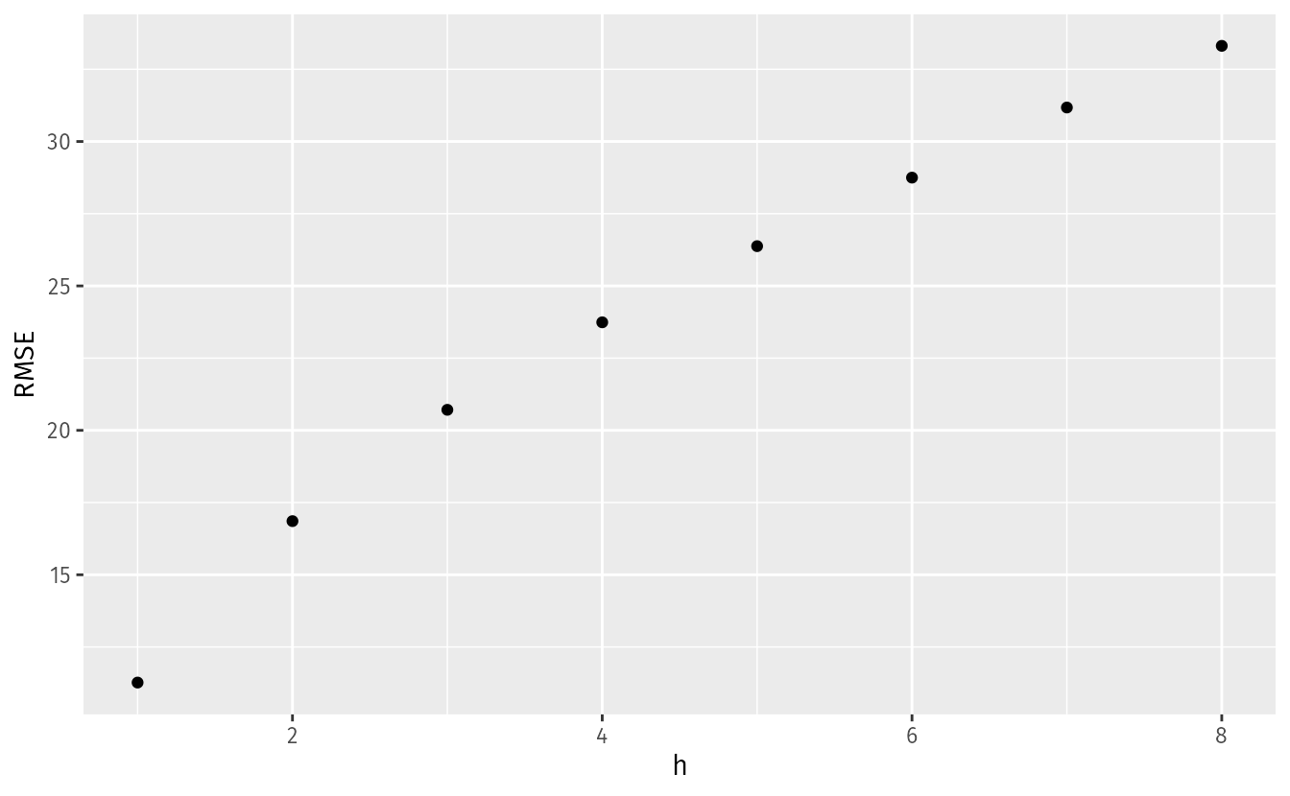
Choose the error measure from the cost of a mistake
• Mean Absolute Error (MAE): the average size of the error.
• Root Mean Squared Error (RMSE): gives extra weight to large errors.
• Mean Absolute Scaled Error (MASE): compares the model with a naïve forecast.
• Quantile loss: useful when under- and over-prediction have different costs.
Show error separately for each forecast horizon and operating condition.
Notes:
[Timing: 2.5 minutes]
Link the metric to the decision. RMSE is appropriate when large misses are disproportionately costly; quantile loss handles asymmetric costs. Explain why MAPE behaves badly near zero.
[Sources]
- Visual: Hyndman & Athanasopoulos, Forecasting: Principles and Practice, 3rd ed., https://otexts.com/fpp3/tscv.html
- Hyndman & Koehler (2006), Another look at measures of forecast accuracy.

Slide 39
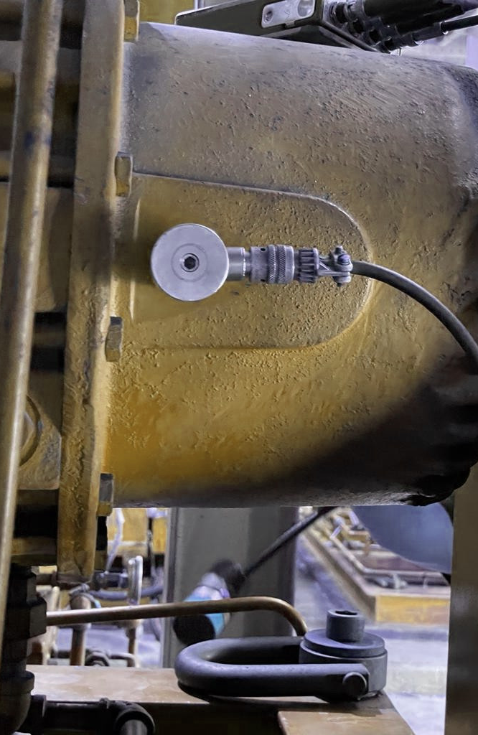
Example: forecast machine vibration 1–10 seconds ahead
• Output: future vibration level and probability of crossing an alarm.
• Inputs: recent acceleration, speed, load, planned control and sensor health.
• Test: train on earlier runs; hold out a later run, machine or operating condition.
• Compare: naïve and Autoregressive (AR) baselines; report error and interval coverage.
The intended decision determines the output, inputs, test and metric.
Notes:
[Timing: 2.5 minutes]
Run this as a formulation exercise. Ask what changes if the aim is anomaly detection rather than forecasting, or if future load is unknown. Make the information boundary explicit.
[Sources]
- Visual: InviCom vibration monitoring sensor, https://invicom.com/applications/vibration-monitoring
- Illustrative engineering task synthesised from the supplied time-series material.

Slide 40
Fourier analysis can forecast stable cycles
1. OBSERVE THE SIGNAL
2. FIND DOMINANT FREQUENCIES
3. CONTINUE THEIR PHASE
f1
f2
f3
f4
f5
ŷₜ₊ₕ = Σₖ Âₖ cos[2πfₖ(t+h)+φ̂ₖ]
• Works when: frequencies and phase remain stable.
• Fails when: amplitude, frequency or operating regime drifts.
• Hybrid: harmonic terms model periodic structure; Autoregressive (AR), Gaussian Process (GP) or neural models capture the residual.
Use the Fast Fourier Transform (FFT) to find cycles; extrapolate them only if the cycles remain stable.
Notes:
[Timing: 2.5 minutes]
Build the mapping from the time history to a small set of sinusoidal coefficients, then extrapolate phase into the forecast horizon. Contrast deterministic harmonic regression with stochastic models for the residual. Emphasise instability under frequency or regime drift.
[Sources]
- Visual constructed from the DFT and harmonic-regression concepts in the supplied PDFs.
- Hyndman & Athanasopoulos, Forecasting: Principles and Practice, 3rd ed., dynamic harmonic regression.

Slide 41
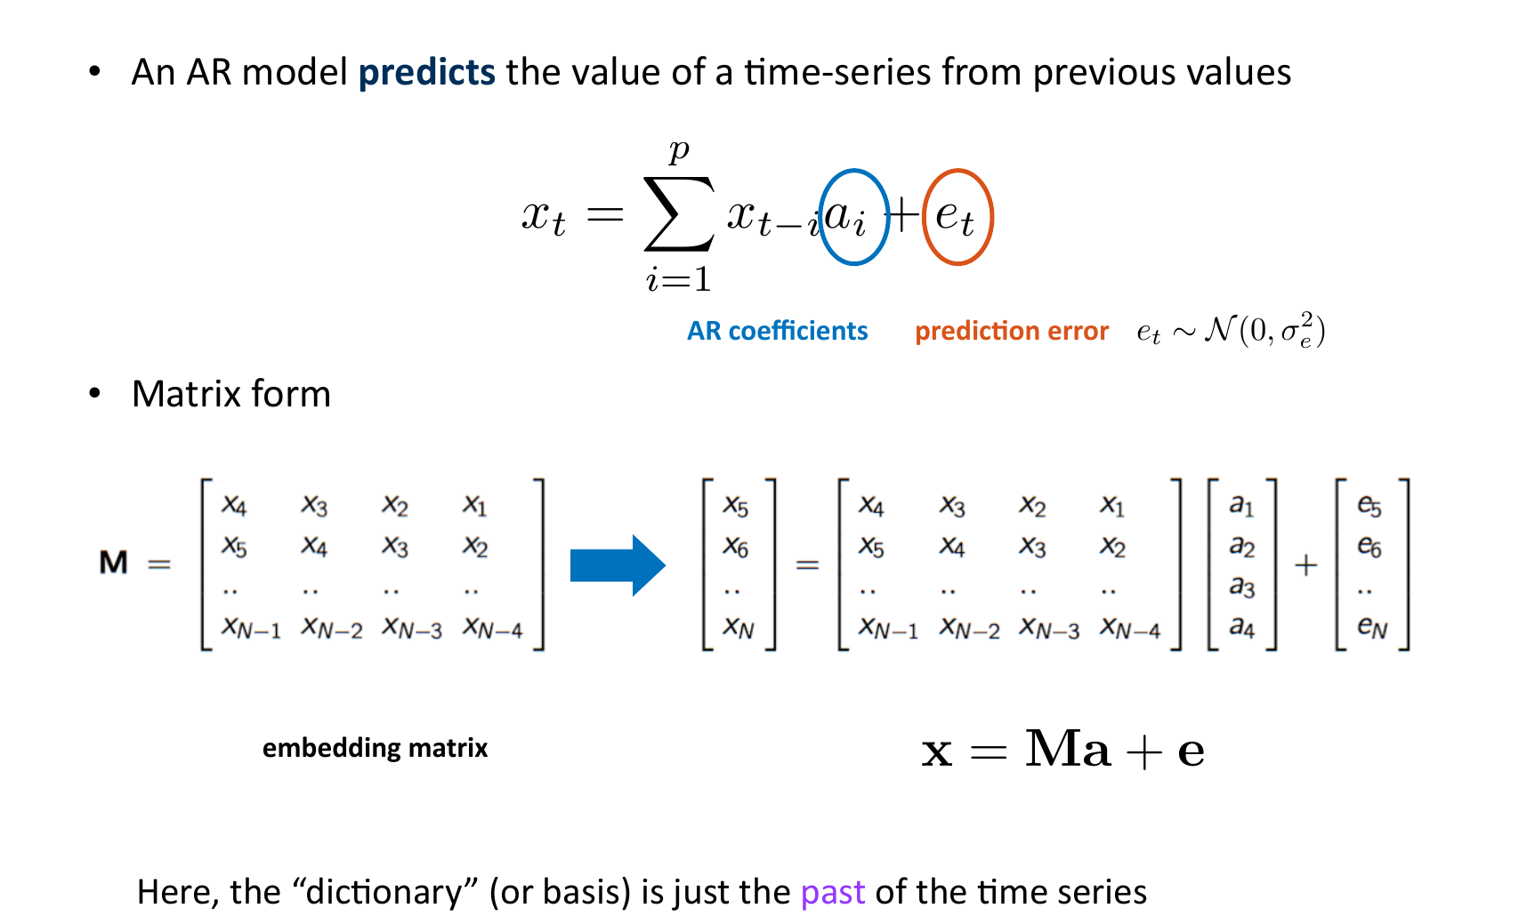
An autoregressive model predicts from recent values
Notes:
[Timing: 2 minutes]
Timing: approximately 2 minutes.
Teaching notes: Use the supplied source figure as the teaching focus. Follow its derivation or build in the printed order, define every symbol, and connect the final statement to the previous slide.
[Sources]
- Provided IE_CDT_SP_HT25_D2.pdf, page 115.

Slide 42
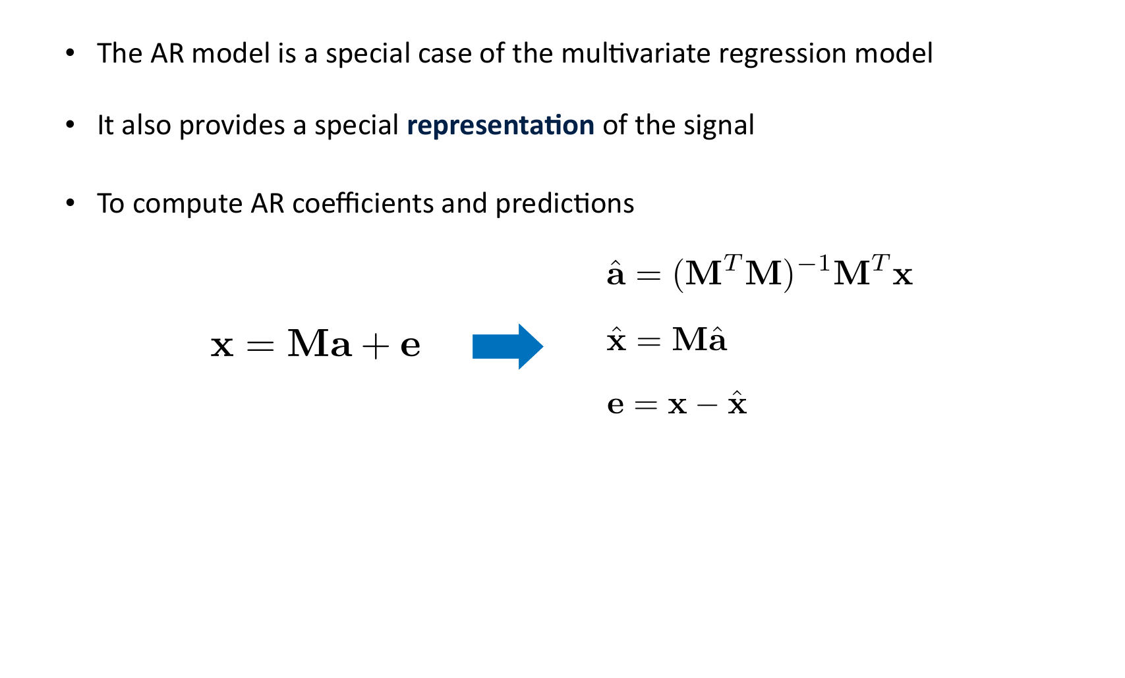
Autoregressive fitting is regression on lagged values
Notes:
[Timing: 2 minutes]
Timing: approximately 2 minutes.
Teaching notes: Use the supplied source figure as the teaching focus. Follow its derivation or build in the printed order, define every symbol, and connect the final statement to the previous slide.
[Sources]
- Provided IE_CDT_SP_HT25_D2.pdf, page 117.

Slide 43
Estimate autoregressive weights by least squares
Notes:
[Timing: 2 minutes]
Timing: approximately 2 minutes.
Teaching notes: Use the supplied source figure as the teaching focus. Follow its derivation or build in the printed order, define every symbol, and connect the final statement to the previous slide.
[Sources]
- Provided IE_CDT_SP_HT25_D2.pdf, page 121.

Slide 44
A four-lag autoregressive model cuts residual variance by 80%
Notes:
[Timing: 2 minutes]
The purple dashed line is the one-step AR(4) prediction and the charcoal line is the observed signal. The residual plot uses the same vertical scale. Compare σ²ₑ = 0.079 with σ²ₓ = 0.3882: the model explains substantial predictable variation but leaves irregular innovations.
[Sources]
Exact series digitised from the supplied PDF Figure 4.9; AR coefficients [1.46, −1.08, 0.60, −0.186]ᵀ.

Slide 45
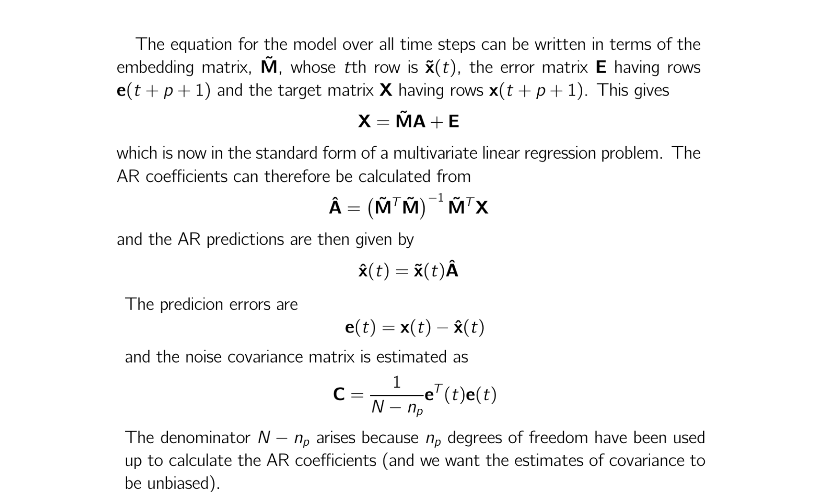
Repeat the autoregressive model to forecast several steps
Notes:
[Timing: 2 minutes]
Timing: approximately 2 minutes.
Teaching notes: Use the supplied source figure as the teaching focus. Follow its derivation or build in the printed order, define every symbol, and connect the final statement to the previous slide.
[Sources]
- Provided IE_CDT_SP_HT25_D2.pdf, page 143.

Slide 46
3. Choose a model that matches the data
Notes:
[Timing: 0.5 minutes]
Frame model selection as matching assumptions, representation, data volume, horizon and uncertainty needs—not as choosing the newest algorithm.
[Sources]
- Narrative structure synthesised from the supplied two-day time-series material and S3-L1/S3-L2/S3-L3 learning outcomes.

Slide 47
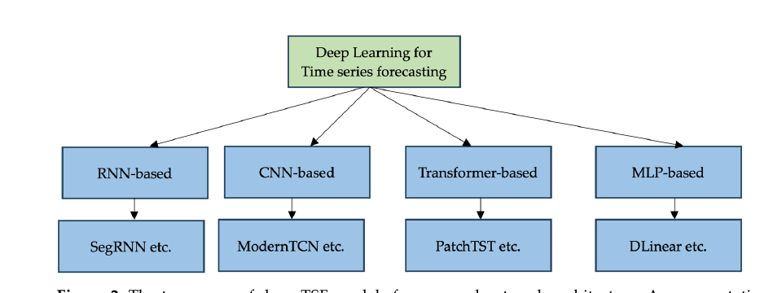
Start simple; add complexity only when the data need it
• Classical: Error–Trend–Seasonal, Autoregressive Integrated Moving Average, Vector Autoregression and state-space models: strong with limited data and clear structure.
• Gaussian Process: smooth nonlinear forecast with uncertainty.
• Sequence models: Temporal Convolutional Network, Recurrent Neural Network, Long Short-Term Memory, Gated Recurrent Unit and Deep Autoregressive models learn from ordered windows.
• Newer models: Neural Basis Expansion, Neural Hierarchical Interpolation, Temporal Fusion Transformer and Patch Time-Series Transformer target longer or multivariate forecasts.
Random forests and boosting can use lagged features, but they do not model sequence order directly.
Diagram: CNN = convolutional neural network; RNN = recurrent neural network; TCN = temporal convolutional network.
Choose the simplest model that meets the accuracy, horizon and uncertainty needs.
Notes:
[Timing: 2 minutes]
Use this as the model map. Trees and boosting enter only after converting the sequence into a lag table; they remain useful nonlinear baselines but do not carry temporal state or causality automatically.
[Sources]
- Visual adapted from Deep Time Series Forecasting Models: A Comprehensive Survey, Mathematics 2024, https://www.mdpi.com/2227-7390/12/10/1504
- Lim & Zohren (2021), Time-series forecasting with deep learning: a survey.

Slide 48
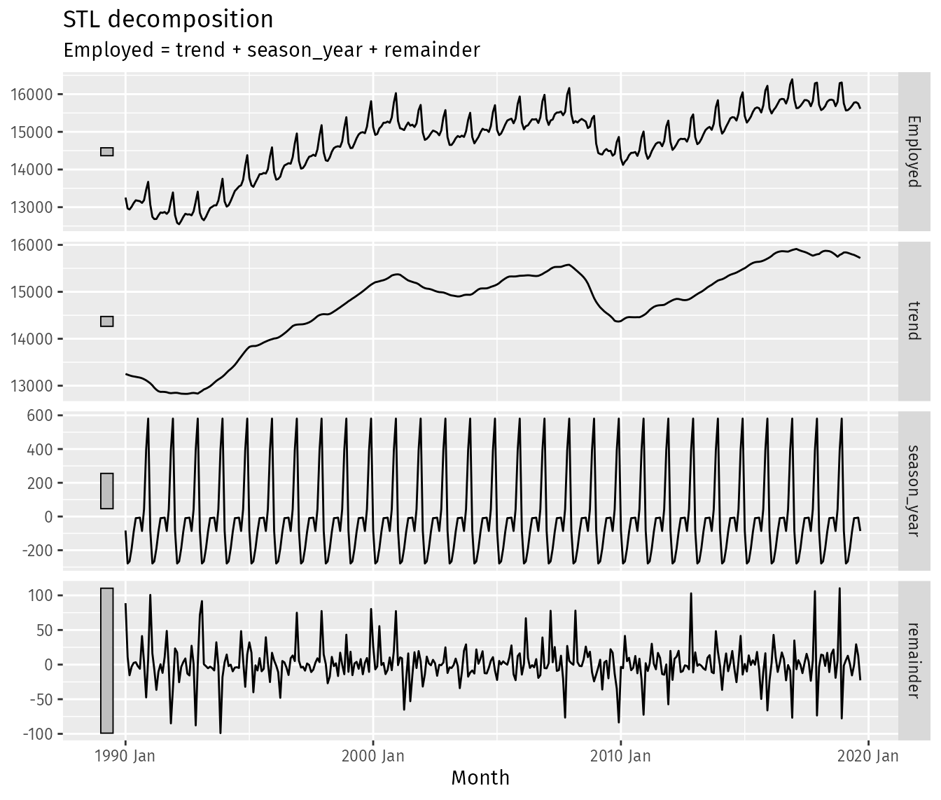
Classical models are strong when the structure is clear
• Error–Trend–Seasonal (ETS): updates level, trend and seasonality.
• Autoregressive Integrated Moving Average (ARIMA): models dependence between recent values and past errors.
• Vector Autoregression (VAR): models several interacting signals.
• State-space model: estimates a hidden system state from noisy measurements.
These models are interpretable, data-efficient and often difficult to beat.
Notes:
[Timing: 3 minutes]
Connect decomposition to explicit components in ETS and dynamic regression. Explain that ARIMA and many exponential-smoothing models also have state-space representations, so these families are related rather than isolated boxes.
[Sources]
- Visual: Hyndman & Athanasopoulos, Forecasting: Principles and Practice, 3rd ed., https://otexts.com/fpp3/stl.html

Slide 49
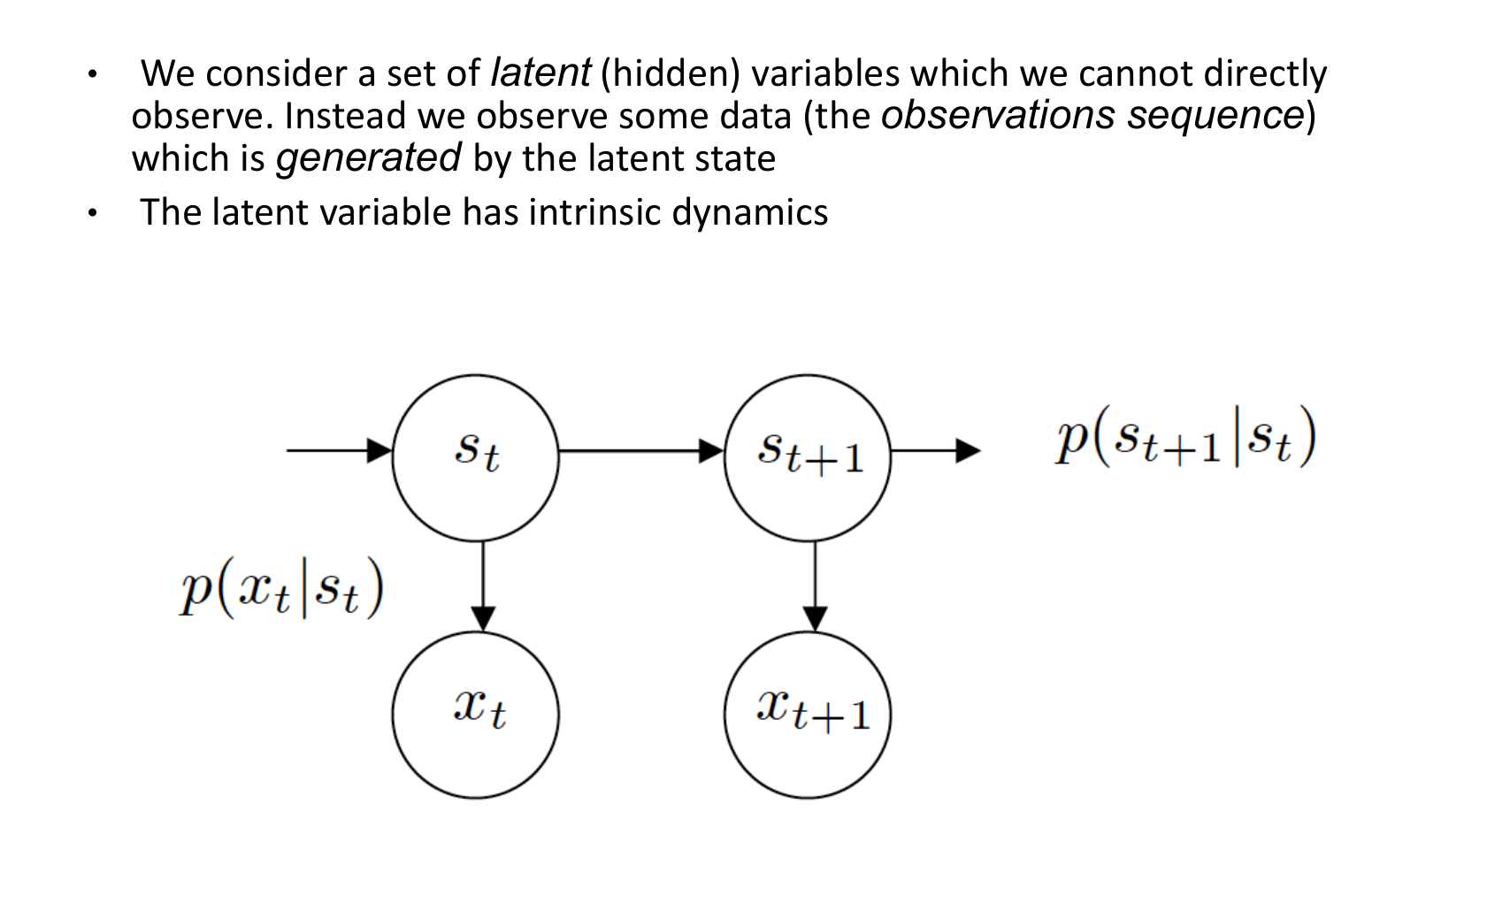
State-space models estimate a hidden system state
Notes:
[Timing: 2 minutes]
Timing: approximately 1.5 minutes.
Teaching notes: Use the supplied source figure as the teaching focus. Follow its derivation or build in the printed order, define every symbol, and connect the final statement to the previous slide.
[Sources]
- Provided IE_CDT_SP_HT25_D2.pdf, page 149.

Slide 50
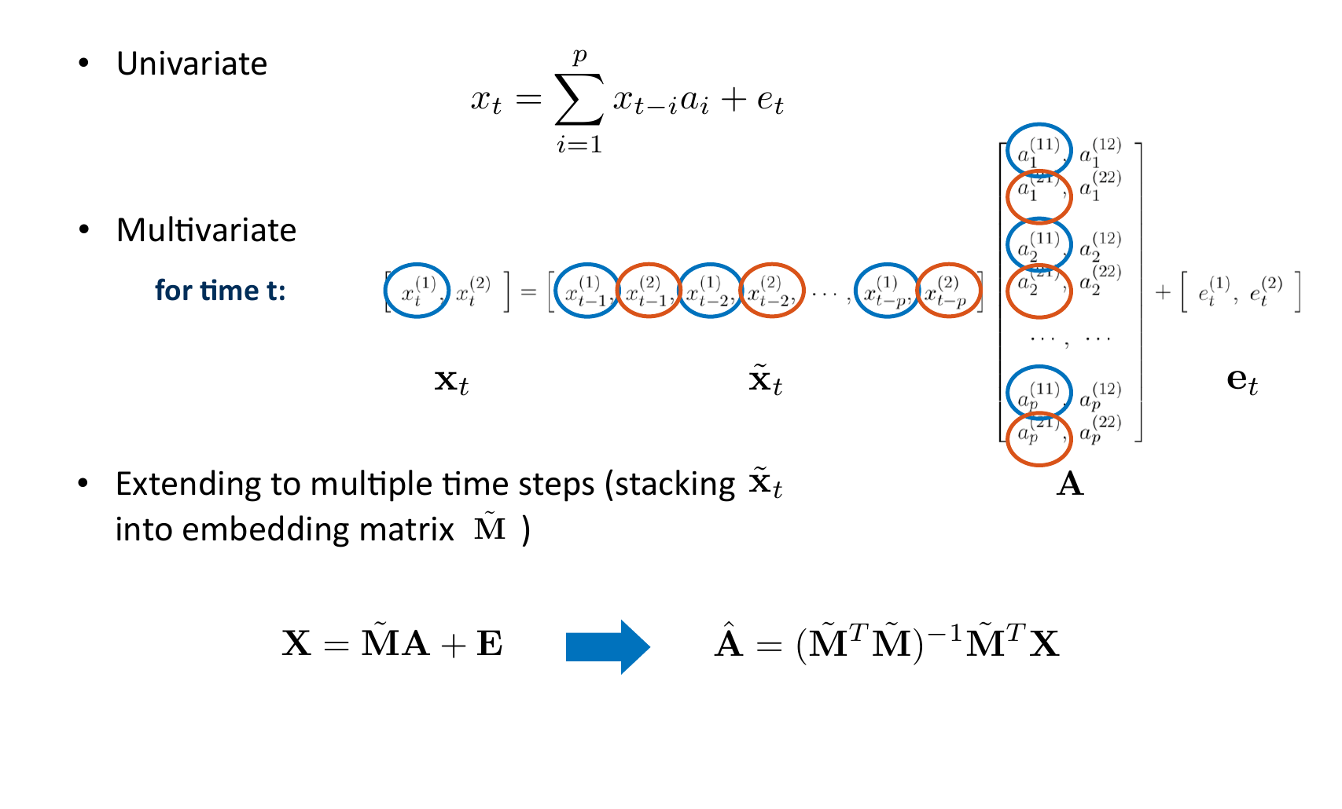
Vector autoregression models interacting time series
Notes:
[Timing: 1.5 minutes]
Timing: approximately 2 minutes.
Teaching notes: Use the supplied source figure as the teaching focus. Follow its derivation or build in the printed order, define every symbol, and connect the final statement to the previous slide.
[Sources]
- Provided IE_CDT_SP_HT25_D2.pdf, page 142.

Slide 51
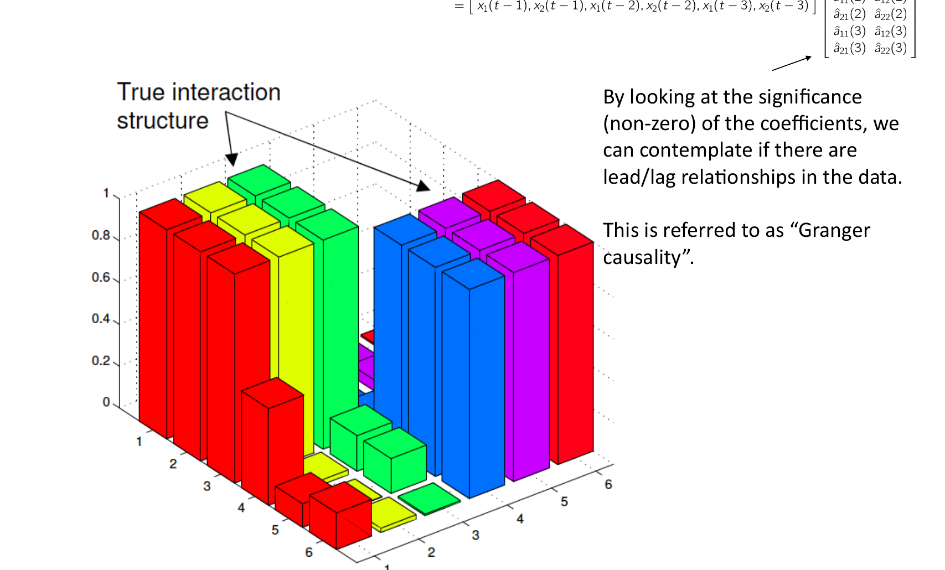
Granger testing asks whether one signal improves prediction of another
Notes:
[Timing: 0.5 minutes]
Timing: approximately 2 minutes.
Teaching notes: Use the supplied source figure as the teaching focus. Follow its derivation or build in the printed order, define every symbol, and connect the final statement to the previous slide.
[Sources]
- Provided IE_CDT_SP_HT25_D2.pdf, page 147.

Slide 52
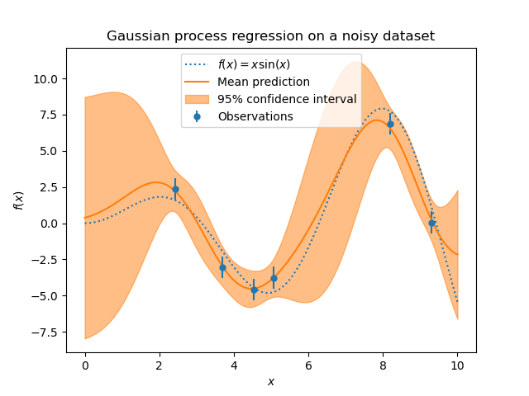
A Gaussian process predicts a curve and its uncertainty
Gaussian process (GP) notation: f(t) ~ GP(m(t), k(t,t′))
• Prior: before seeing data, specify what kinds of functions are plausible.
• Kernel: defines how similarity falls with time and how periodicity repeats.
• Posterior: after seeing data, update the mean forecast and uncertainty band.
• Limit: exact Gaussian-process training becomes expensive for very long series.
μ* = K*ᵀ(K+σ²I)⁻¹y Σ* = K** − K*ᵀ(K+σ²I)⁻¹K*
Gaussian processes suit small-to-medium scientific datasets where uncertainty is important.
Notes:
[Timing: 3 minutes]
Introduce the prior over functions, then explain that the kernel is a modelling assumption about temporal similarity. Walk through the posterior mean and covariance at a conceptual level. Mention periodic and locally periodic kernels, and the O(n^3) exact-training limitation.
[Sources]
- Visual: scikit-learn Gaussian-process regression example, BSD-3-Clause, https://scikit-learn.org/stable/auto_examples/gaussian_process/plot_gpr_noisy_targets.html
- Rasmussen & Williams (2006), Gaussian Processes for Machine Learning.

Slide 53
A temporal convolutional network combines patterns across the past
d = 4
ŷₜ
d = 2
d = 1
input
t−7
t−6
t−5
t−4
t−3
t−2
t−1
t
One forecast combines information from several layers of the past.
• Causal: uses only present and past values.
• Dilated: skips farther back at higher layers, increasing the receptive field.
• Parallel: processes the entire input window at once during training.
hₜ⁽ˡ⁾ = σ(b⁽ˡ⁾ + Σⱼ wⱼ⁽ˡ⁾ hₜ₋dⱼ⁽ˡ⁻¹⁾)
Notes:
[Timing: 2.5 minutes]
Relate a 1D convolution to a learned FIR filter. Causality prevents future leakage; dilation grows the receptive field without a long recurrent chain. Ask how many past samples are visible after several layers.
[Sources]
- Visual: Bai, Kolter & Koltun (2018), An Empirical Evaluation of Generic Convolutional and Recurrent Networks for Sequence Modeling, https://arxiv.org/abs/1803.01271

Slide 54
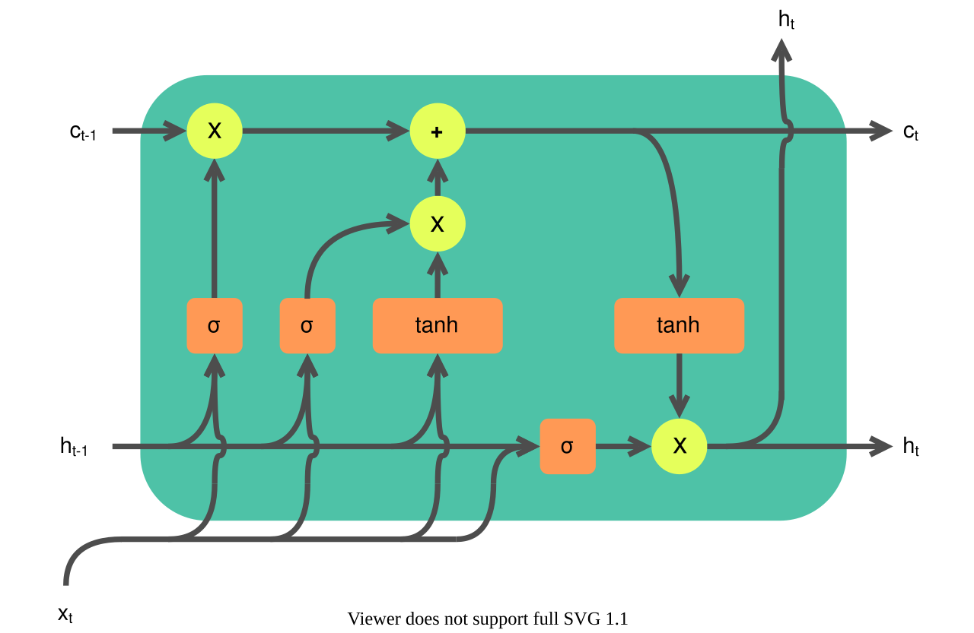
Recurrent networks carry memory; gated networks decide what to keep
• Recurrent Neural Network (RNN): updates its memory as each new sample arrives.
• Long Short-Term Memory (LSTM) and Gated Recurrent Unit (GRU): gates keep useful information and forget irrelevant information.
• Deep Autoregressive model (DeepAR): trains one probabilistic Recurrent Neural Network across many related time series.
• Limit: training is sequential and long memories can be hard to learn.
These models help when the order and evolving memory of the signal matter.
Notes:
[Timing: 3 minutes]
Explain the shared recurrent update, then use the diagram to identify the input, forget and output gates. Contrast deterministic recurrent regression with DeepAR's distributional output and sharing across related series.
[Sources]
- Visual: Guillaume Chevalier / Ketograff, LSTM cell, Wikimedia Commons, CC BY 4.0, https://commons.wikimedia.org/wiki/File:LSTM_cell.svg
- Salinas et al. (2020), DeepAR: Probabilistic forecasting with autoregressive recurrent networks.

Slide 55
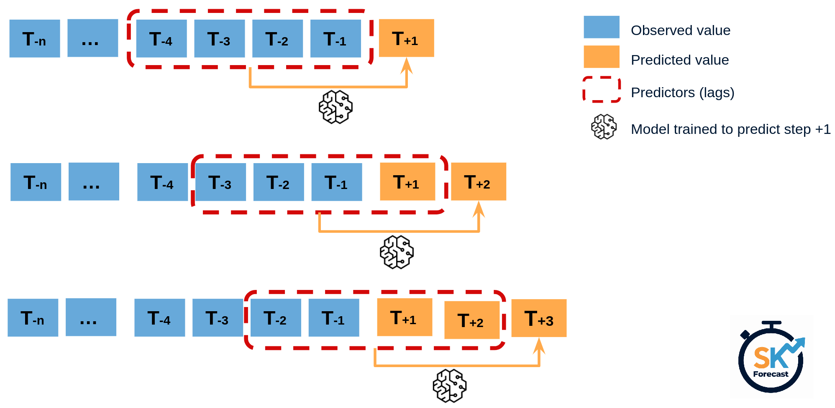
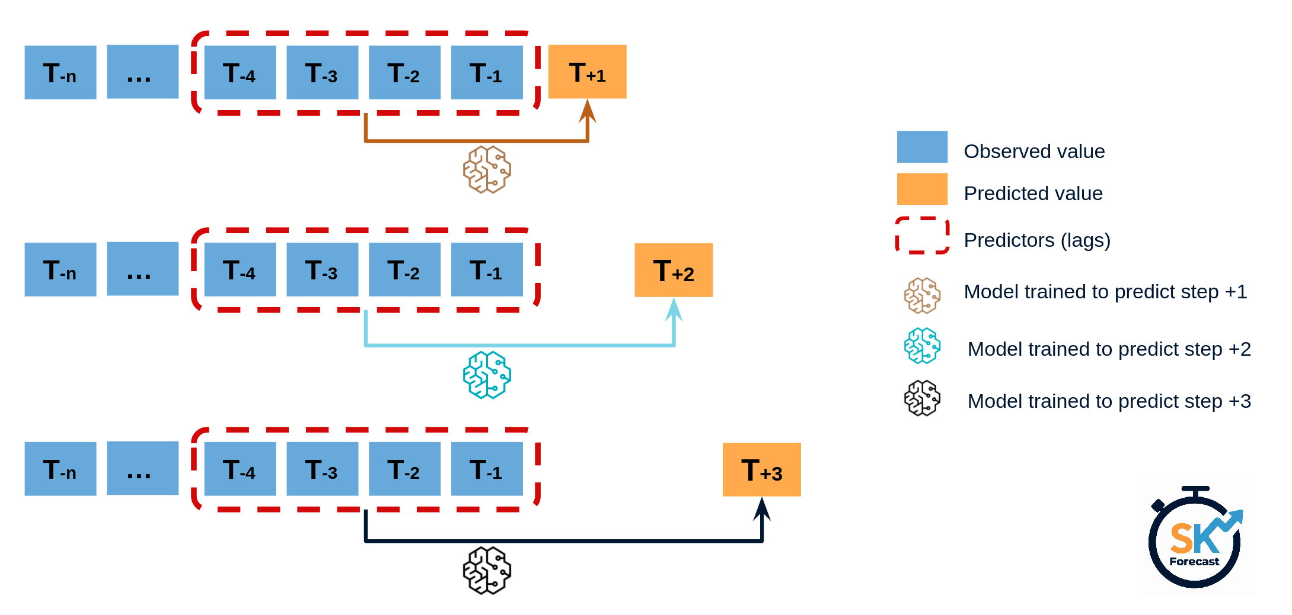
Three common ways to forecast several future steps
RECURSIVE: reuse one-step model
DIRECT: separate output for each horizon
• Recursive: simple, but each prediction becomes the next input, so errors can accumulate.
• Direct: avoids feedback, but needs a separate output or model for each future step.
JOINT / MULTI-OUTPUT — predict the whole future path at once.
Train and test the same strategy that will be used in practice.
Notes:
[Timing: 2.5 minutes]
Compare recursive, direct and multi-output forecasts. Explain exposure bias: a recursive model is trained on observed histories but deployed on its own predictions.
[Sources]
- Visuals: skforecast multi-step forecasting diagrams, https://skforecast.org/latest/introduction-forecasting/introduction-forecasting
- Hyndman & Athanasopoulos, Forecasting: Principles and Practice, 3rd ed.

Slide 56
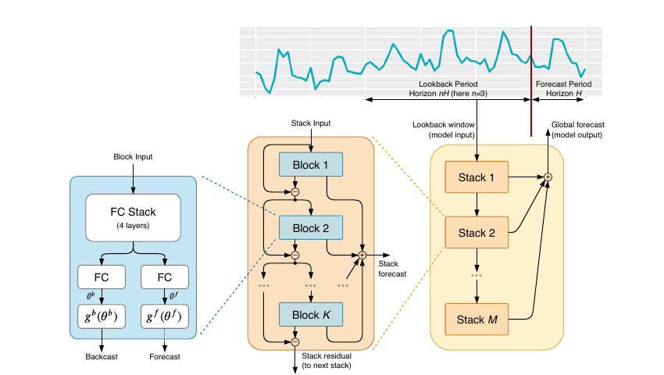
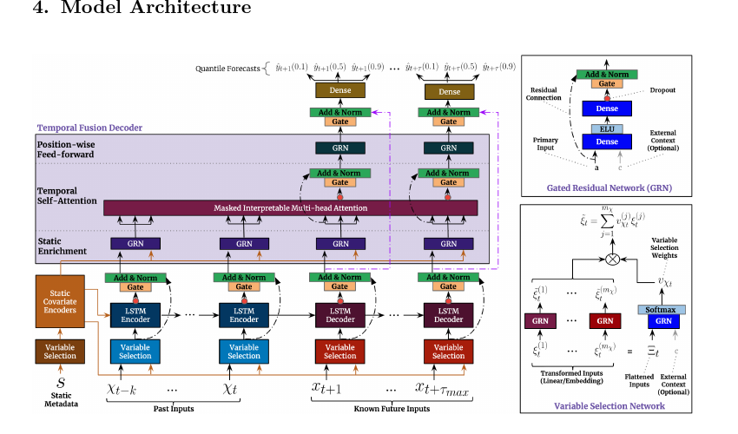
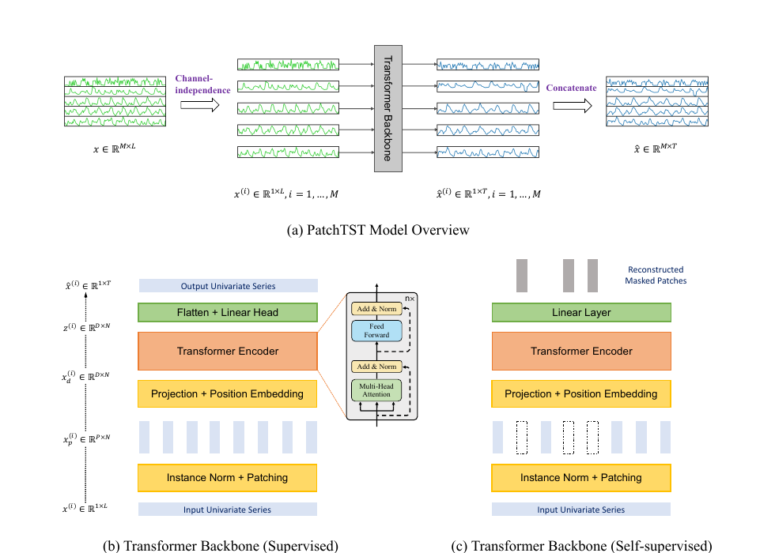
Newer forecasting models organise long histories in different ways
N-BEATS / N-HiTS
Temporal Fusion Transformer
Neural Basis Expansion Analysis for Interpretable Time Series Forecasting (N-BEATS) and Neural Hierarchical Interpolation for Time Series Forecasting (N-HiTS) learn trend-like and seasonal-like blocks across several time scales.
PatchTST
Combines known future inputs, variable selection and attention.
Patch Time-Series Transformer (PatchTST) splits a long history into patches, like words in a sentence.
Deep Autoregressive model (DeepAR) is a useful probabilistic recurrent neural network benchmark. Newer does not automatically mean better.
Notes:
[Timing: 2.5 minutes]
Give a landscape rather than full derivations. N-BEATS and N-HiTS learn basis-like residual expansions; TFT integrates known-future covariates and attention; PatchTST uses channel-wise patches for long contexts. Point students to DeepAR as a common probabilistic RNN baseline.
[Sources]
- Oreshkin et al. (2020), N-BEATS, https://arxiv.org/abs/1905.10437
- Lim et al. (2021), Temporal Fusion Transformers, https://arxiv.org/abs/1912.09363
- Nie et al. (2023), PatchTST, https://arxiv.org/abs/2211.14730
- Challu et al. (2023), N-HiTS.

Slide 57
4. Check whether the forecast can be trusted
Notes:
[Timing: 0.5 minutes]
A forecasting algorithm becomes useful only when uncertainty, interpretation, temporal tuning, distribution shift and deployment-specific evaluation are handled together.
[Sources]
- Narrative structure synthesised from the supplied two-day time-series material and S3-L1/S3-L2/S3-L3 learning outcomes.

Slide 58
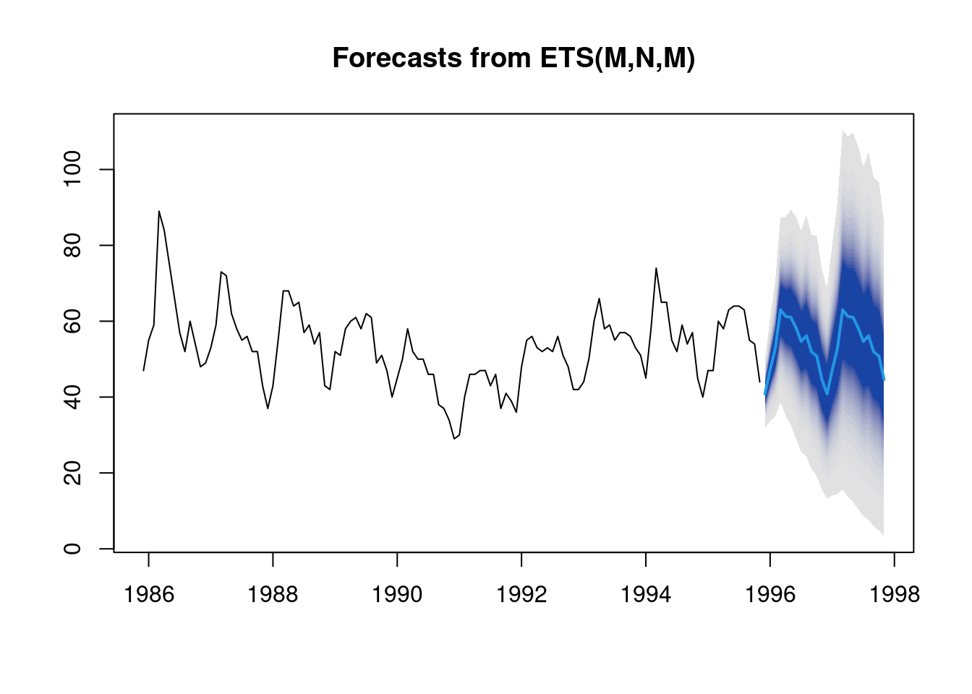
Show a range of plausible futures—not just one line
• Point forecast: the central or decision-optimal value.
• Interval: a range expected to contain the future observation.
• Tail risk: probability of exceeding a safety or operating limit.
• Calibration: a 90% interval should contain about 90% of comparable future observations.
Check coverage and interval width separately at each horizon.
Notes:
[Timing: 2.5 minutes]
Distinguish parameter confidence intervals from prediction intervals. Explain that interval quality has two dimensions: calibration and sharpness. Quantile, likelihood and conformal approaches provide different routes.
[Sources]
- Visual: Rob J Hyndman, Visualisation of probabilistic forecasts, https://robjhyndman.com/hyndsight/visualization-of-probabilistic-forecasts/
- Gneiting & Raftery (2007), Strictly Proper Scoring Rules.

Slide 59
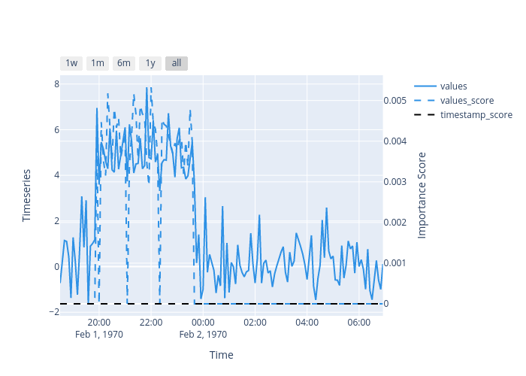
Explain which past values and inputs changed the forecast
• Global explanation: overall lag effects, coefficients or state components.
• Local explanation: why this particular forecast changed.
• Time-aware test: perturb blocks of time or groups of correlated lags.
• Scientific check: confirm units, bounds and known physical behaviour.
Attribution explains model behaviour; it does not establish causality.
Notes:
[Timing: 2.5 minutes]
Show why independent permutation of individual time points destroys sequence structure. Prefer block or grouped perturbations for correlated lags. For scientific forecasting, mechanistic checks may be more useful than a generic feature ranking.
[Sources]
- Visual: Salesforce OmniXAI time-series SHAP tutorial, https://opensource.salesforce.com/OmniXAI/latest/tutorials/timeseries/shap.html
- Lundberg & Lee (2017), SHAP.

Slide 60
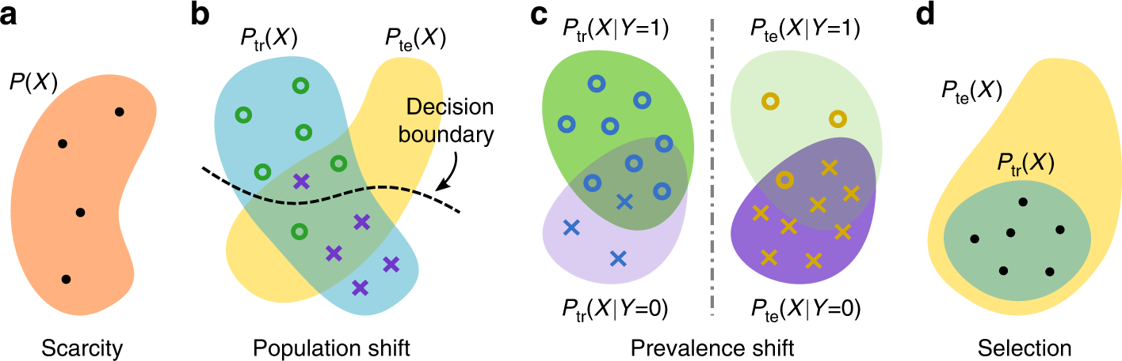
A model can fail when the machine or operating conditions change
• Input change: a different sensor, site, speed or load.
• Relationship change: ageing, control changes or a new failure mode.
• Monitor: inputs, prediction errors and interval coverage.
Report performance by machine, site and regime; an overall average can hide failure.
Notes:
[Timing: 2.5 minutes]
Use sensor recalibration as covariate shift and component degradation as possible concept shift. The medical-imaging diagram is a general vocabulary for thinking about how training and deployment populations differ.
[Sources]
- Visual: Causality matters in medical imaging, Nature Communications 2020, https://www.nature.com/articles/s41467-020-17478-w
- Quionero-Candela et al. (2009), Dataset Shift in Machine Learning.

Slide 61

Tune on earlier periods; keep the final future period untouched
• Earlier periods: choose lags, window length, regularisation and architecture.
• Final future period: estimate performance only after all choices are fixed.
• Entire pipeline: fit scaling and feature selection inside each training window.
Do not use the final test period to choose or refine the model.
Notes:
[Timing: 2.5 minutes]
Sketch nested temporal evaluation. Several earlier origins select hyperparameters; one final untouched future period reports performance. Random search over a random split only optimises leakage.
[Sources]
- Visual: Hyndman & Athanasopoulos, Forecasting: Principles and Practice, 3rd ed., https://otexts.com/fpp3/tscv.html
- Bergmeir & Benítez (2012), cross-validation for time series.

Slide 62

Test the forecast under the conditions in which it will be used
• Prediction: beat simple baselines at every forecast horizon.
• Engineering: test missing sensors, latency, new machines and costly errors.
• Physics: check units, bounds and known constraints.
• Operation: decide monitoring, fallback and retraining rules.
A trustworthy forecast must be accurate, calibrated and usable in practice.
Notes:
[Timing: 3 minutes]
Invite students to identify one statistical, one engineering and one scientific failure that a random test split would miss. Evaluation must reproduce the information, latency and decision loop at deployment.
[Sources]
- Visual: NASA/JPL-Caltech/Lockheed Martin, Preparing NASA's InSight Spacecraft for Vibration Test, https://science.nasa.gov/photojournal/preparing-nasas-insight-spacecraft-for-vibration-test/
- Synthesis of Tashman (2000) and Gneiting & Raftery (2007).

Slide 63

Reliable forecasting is a complete process
UNDERSTAND DATA → DEFINE TASK → BASELINE → MODEL → TEST ON FUTURE DATA → UNCERTAINTY → MONITOR
Good forecasting depends as much on the test and data assumptions as on the chosen model.
Notes:
[Timing: 5 minutes]
Use this as retrieval practice. Ask students to state a target and horizon, one diagnostic, one baseline, one candidate model and one trustworthiness check for their own data.
[Sources]
- Visual: Hyndman & Athanasopoulos, A tidy forecasting workflow, https://otexts.com/fpp3/a-tidy-forecasting-workflow.html
- Integrated synthesis of the supplied PDFs and S3-L1/S3-L2/S3-L3 methodology.

Slide 64
Questions?
For your own data: what would you inspect first, and which simple forecast would you try first?
Notes:
[Timing: 0.5 minutes]
Use the prompt to test whether students now connect model choice with horizon, baselines, temporal validation and trustworthiness.
[Sources]
Session synthesis.

